Slide 1
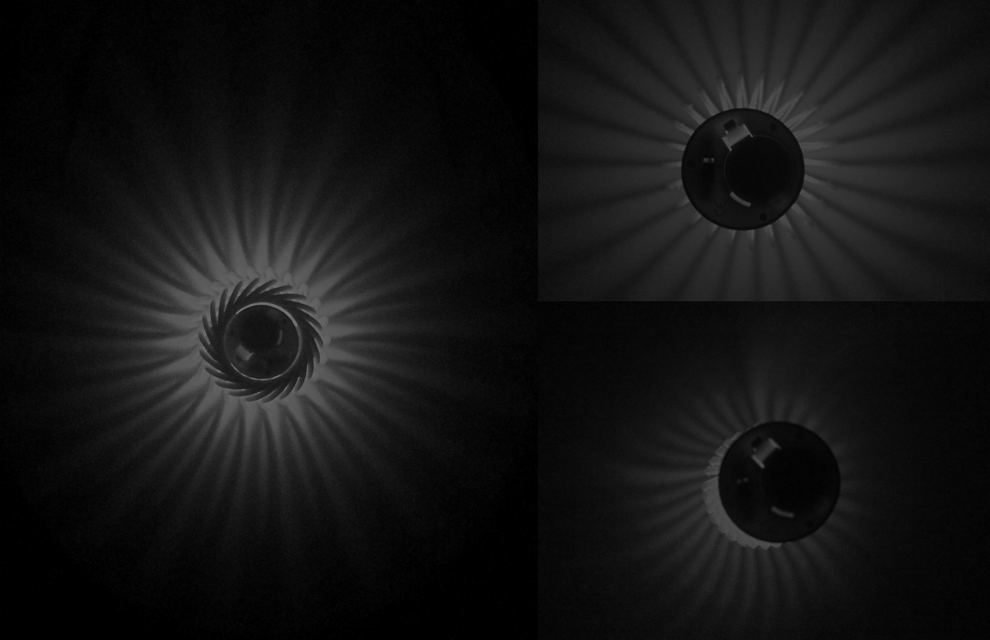
Tea lights
Name - Ridhima Chhibber
INT – 659-01 - Parametric
Instructor - Ben Howes
Session - SP 15

Slide 2
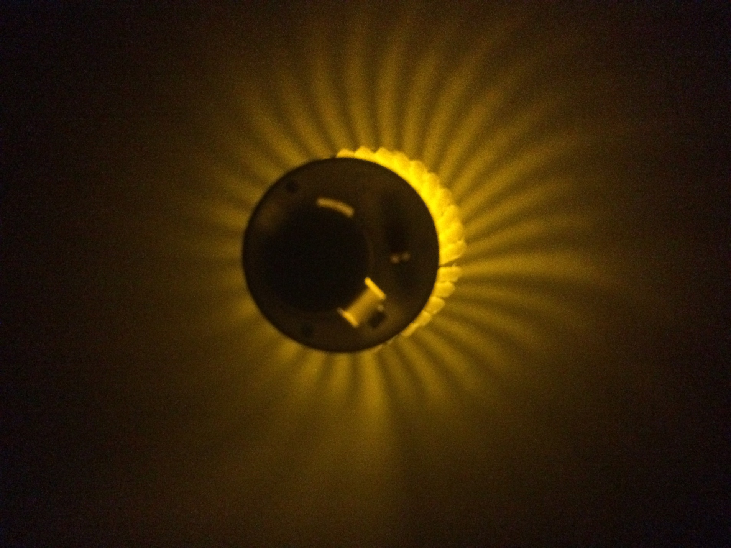
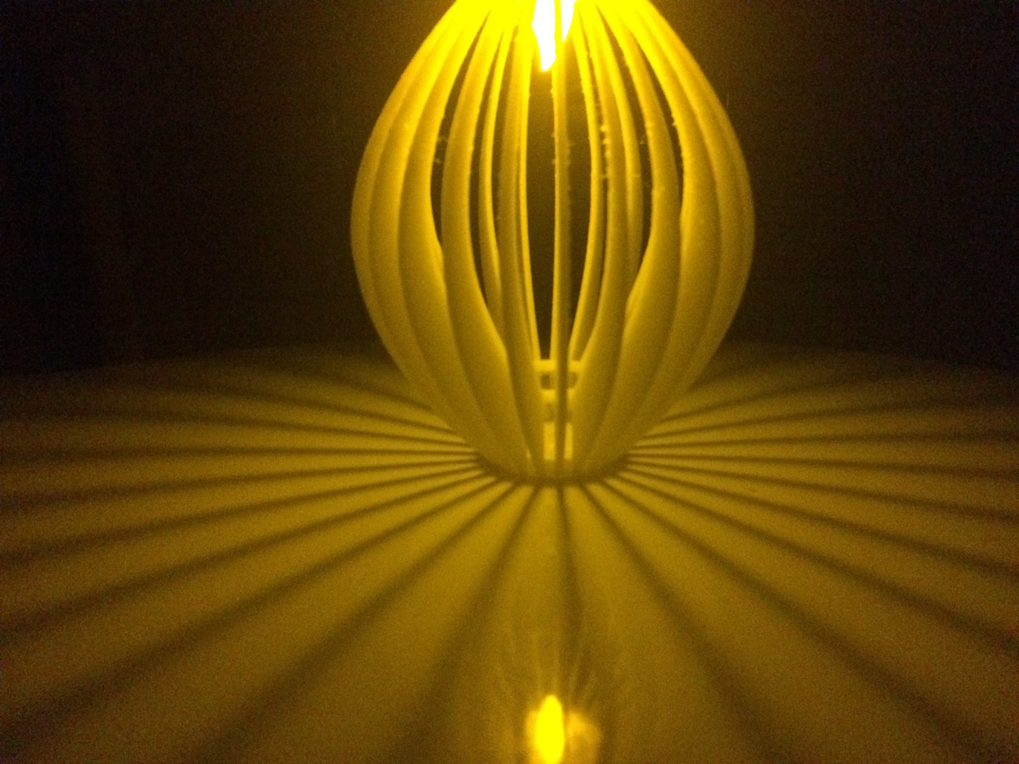
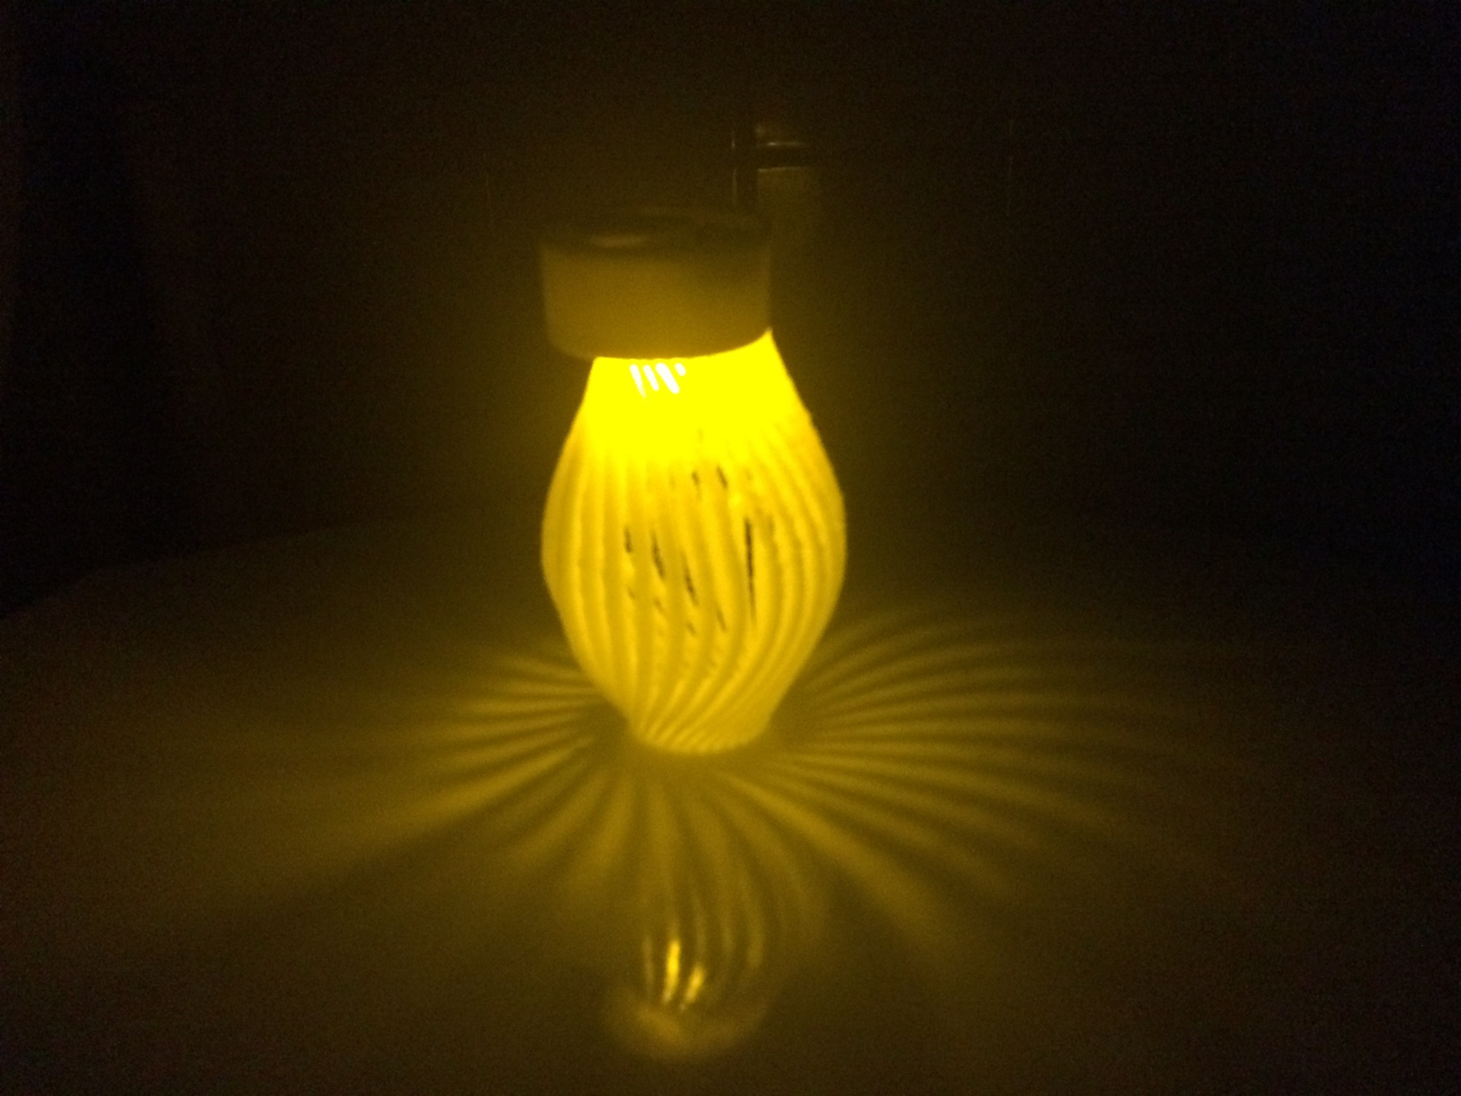
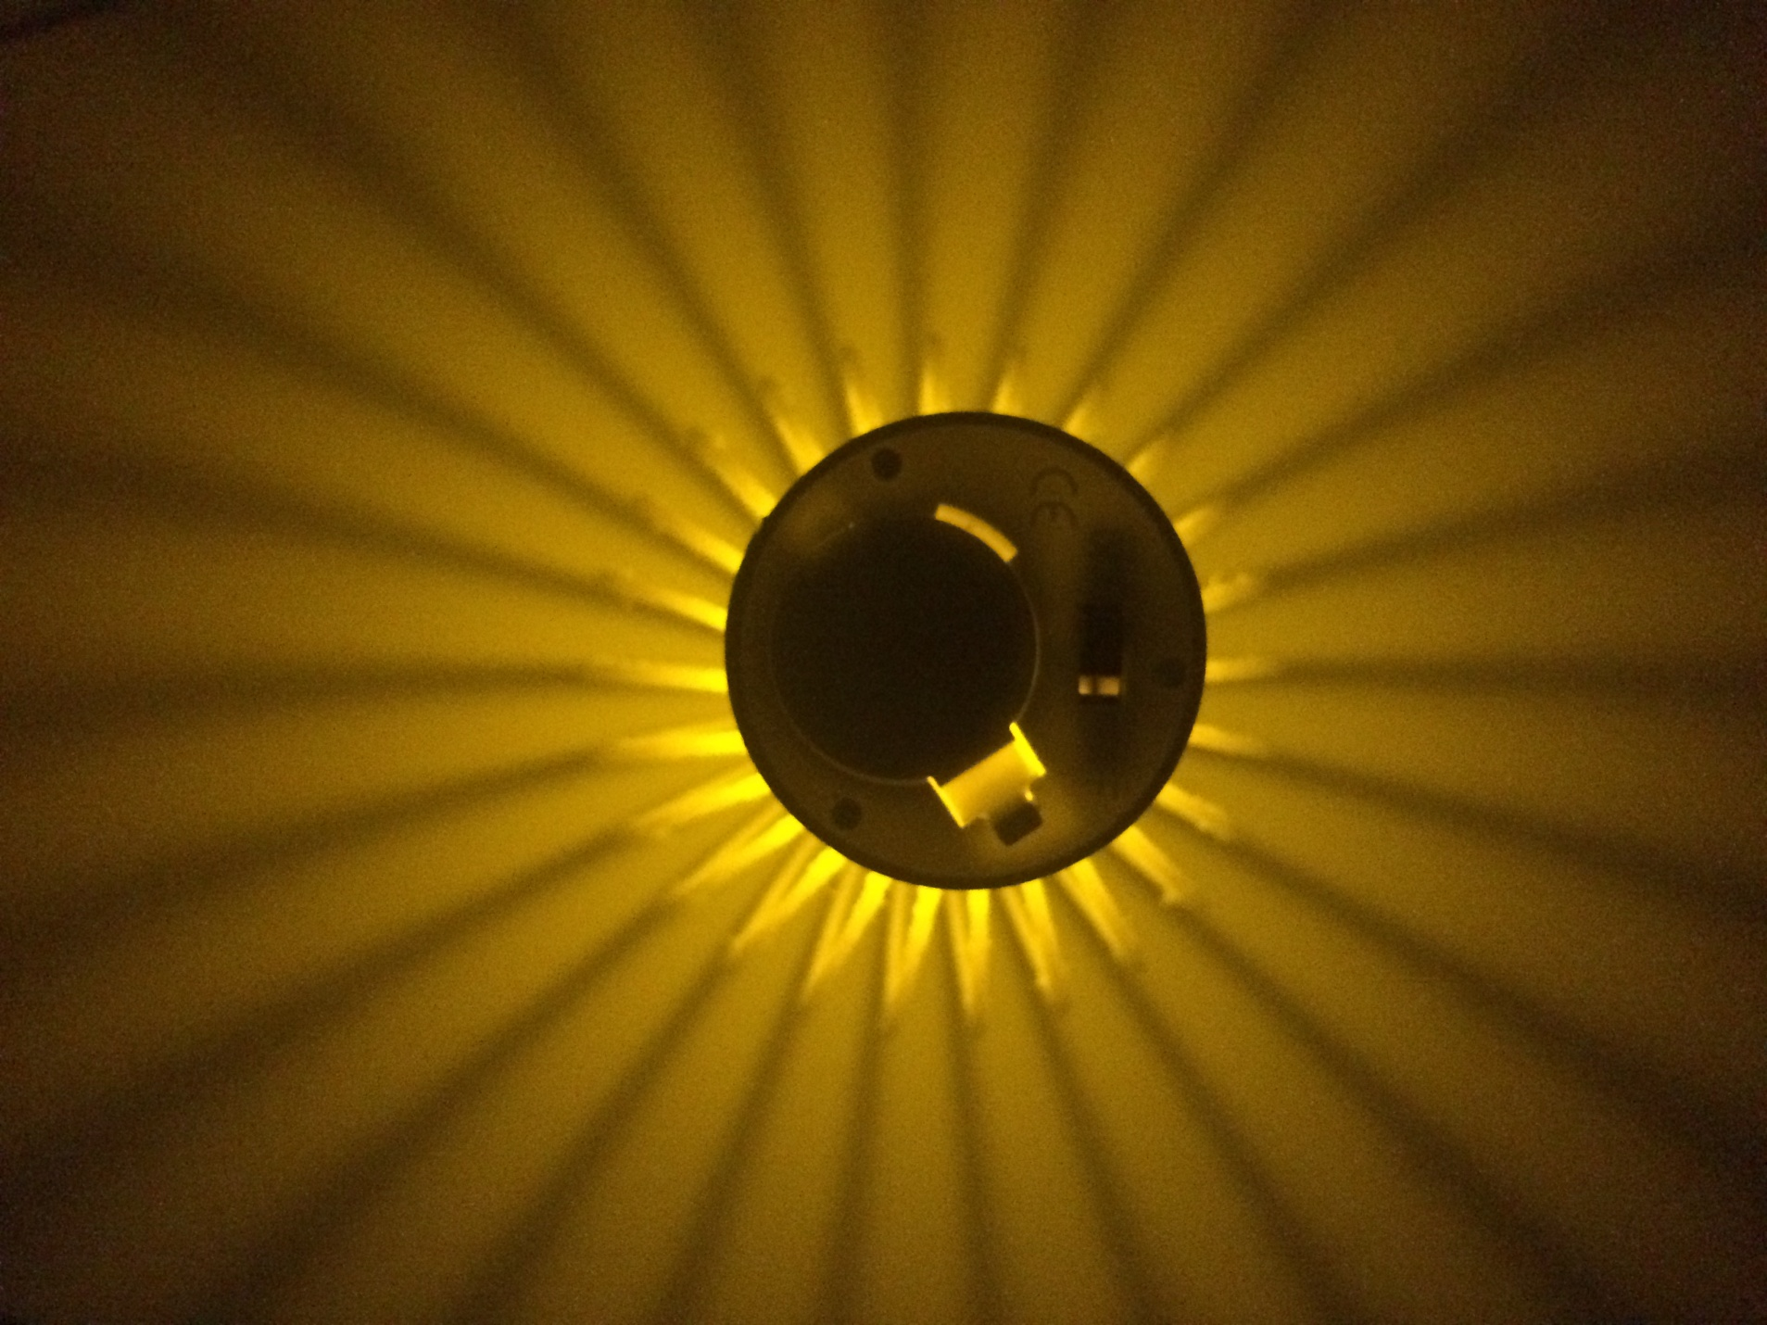
Previous

Slide 3
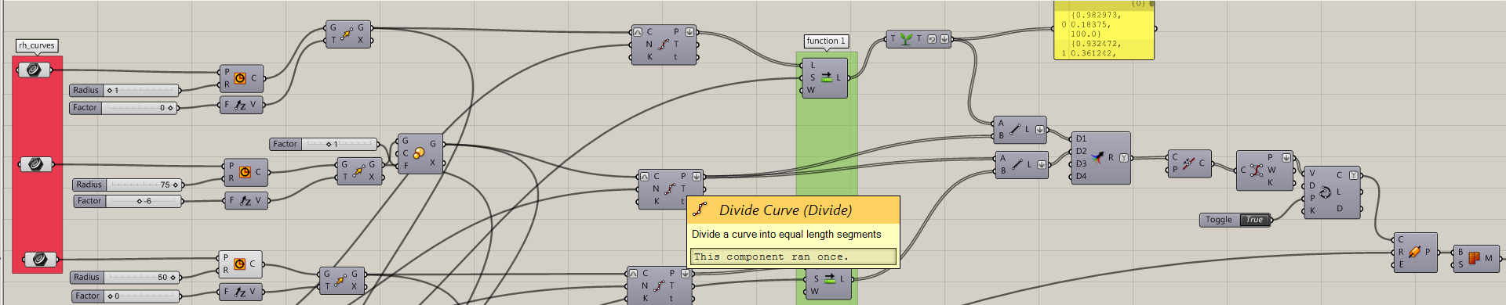
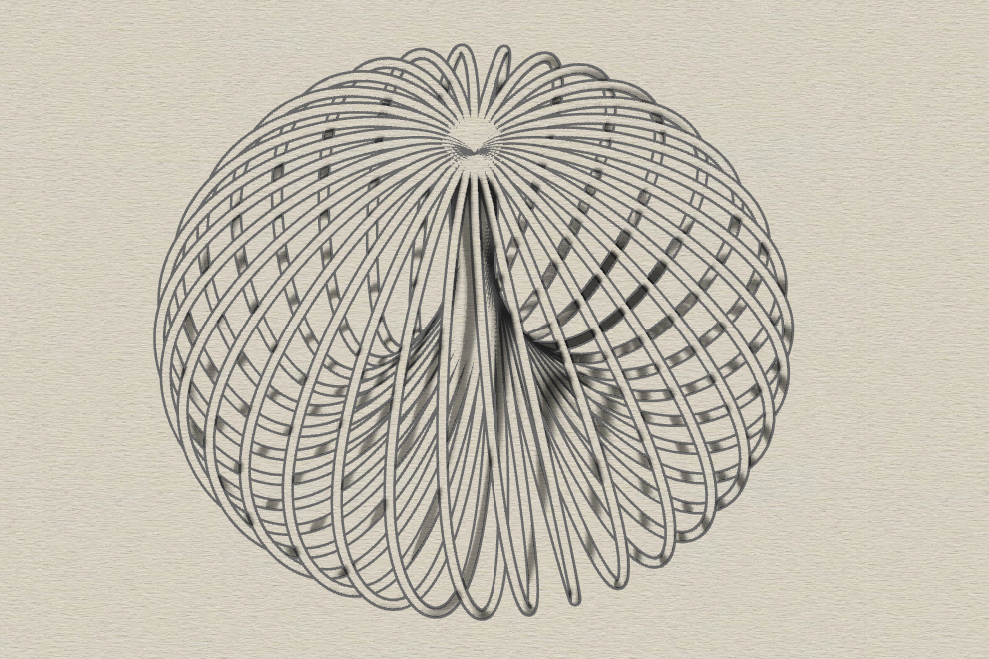
Design derivatives –
Form – (A) Radius and (B) Height ( factor)
Count
Shift
Thickness
Shift overlap
General definition for Tea light
Top radius – 1mm
Factor - 0
Middle radius – 75 mm
Factor – (-)6
Bottom radius – 50 mm
Factor – 0
Count – 34
Shift – 1
Thickness – 1 mm

Slide 4
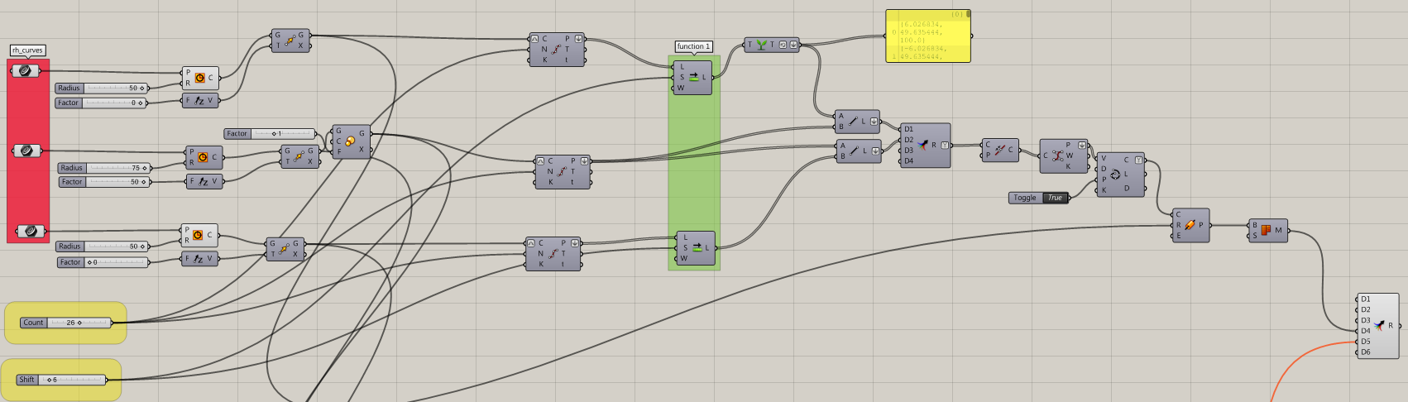
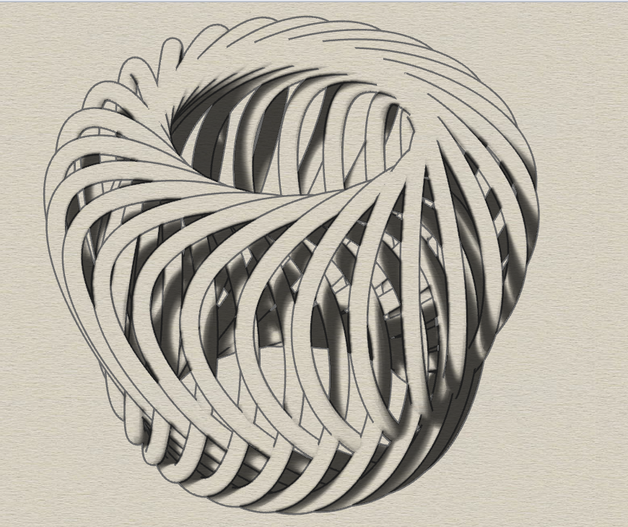
Tea light 1.
Top radius – 50 mm
Factor - 0
Middle radius – 75 mm
Factor – 50
Bottom radius – 50 mm
Factor – 0
Count – 26
Shift – 6
Thickness – 3 mm

Slide 5
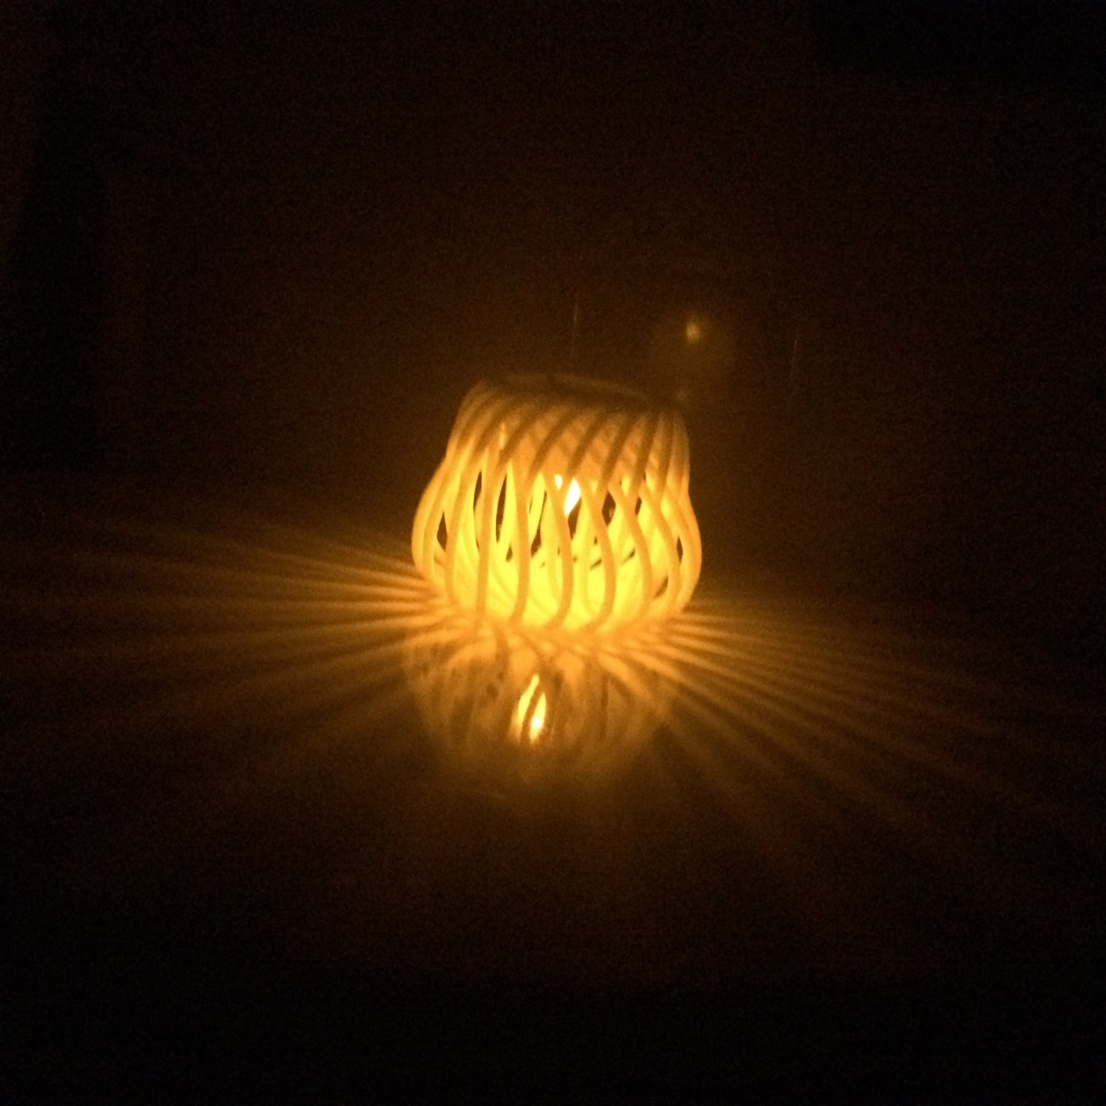
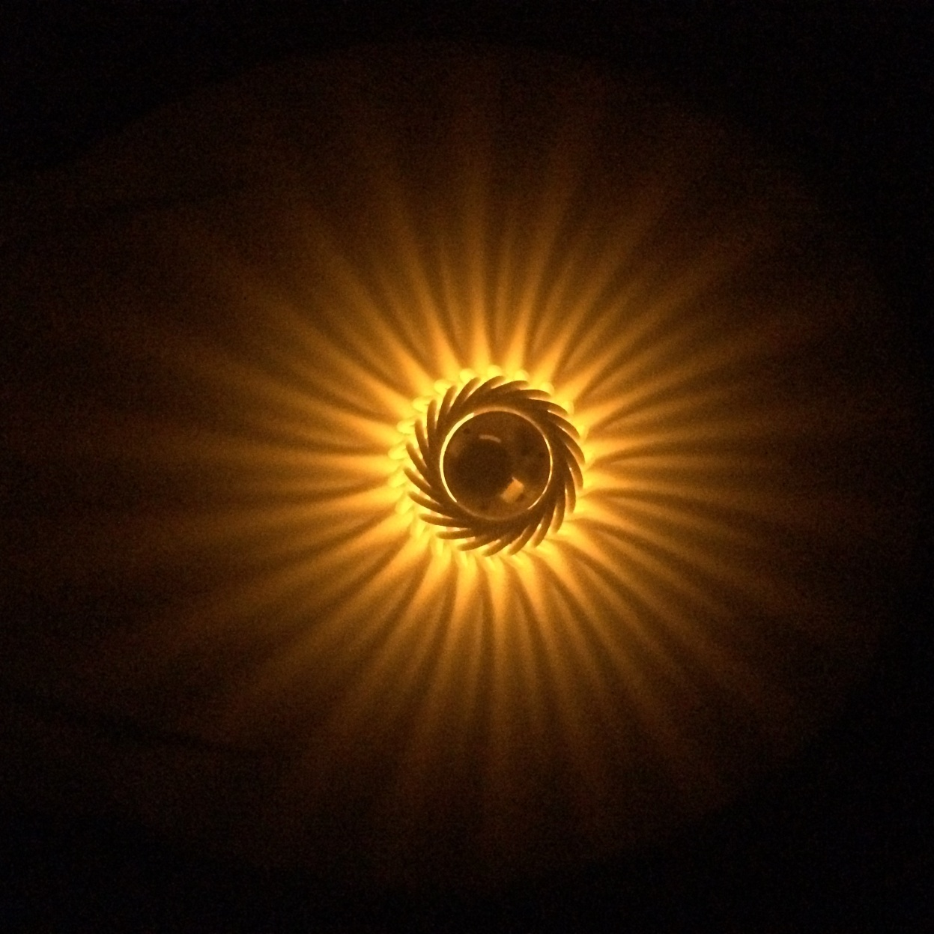
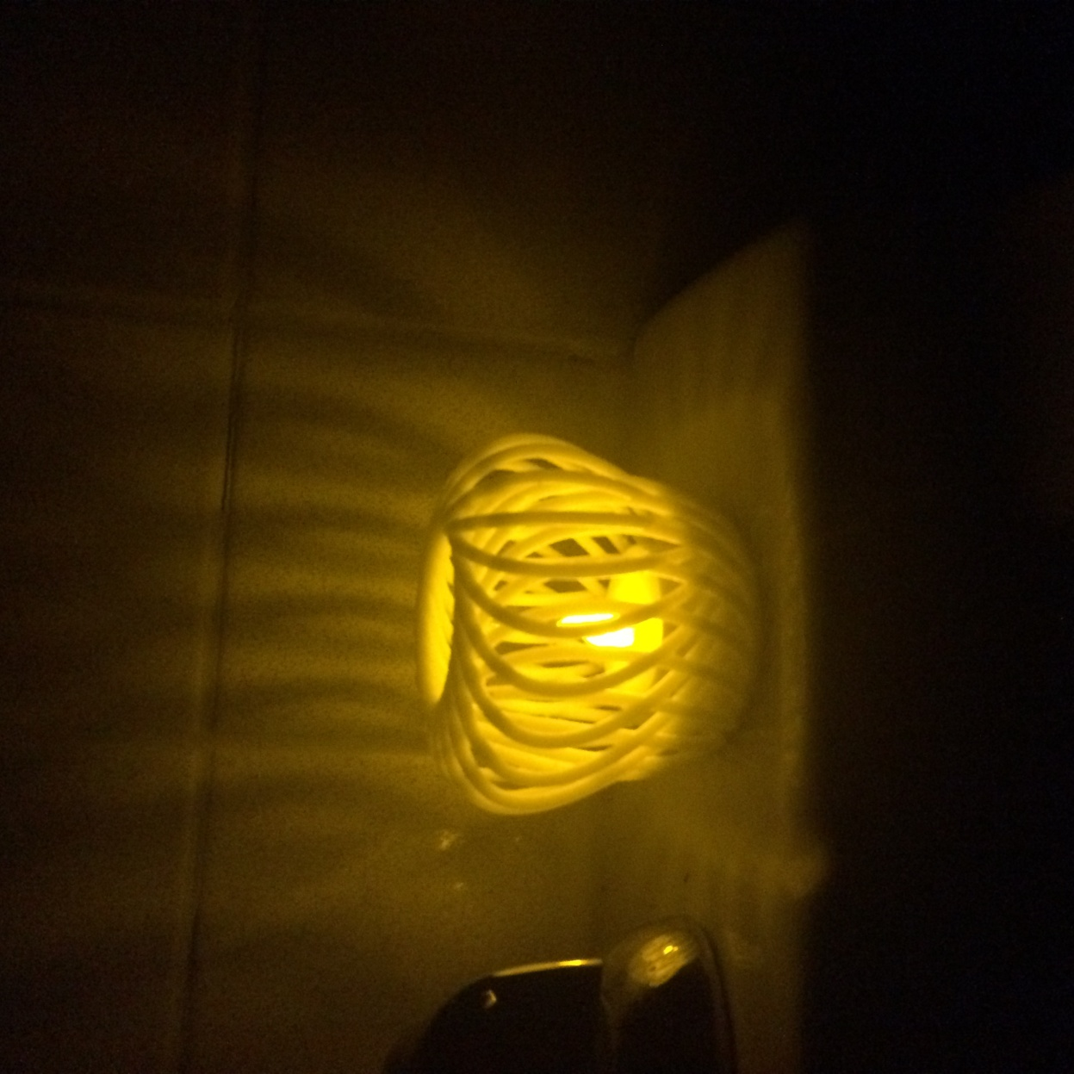

Slide 6
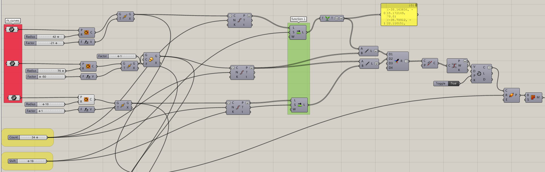
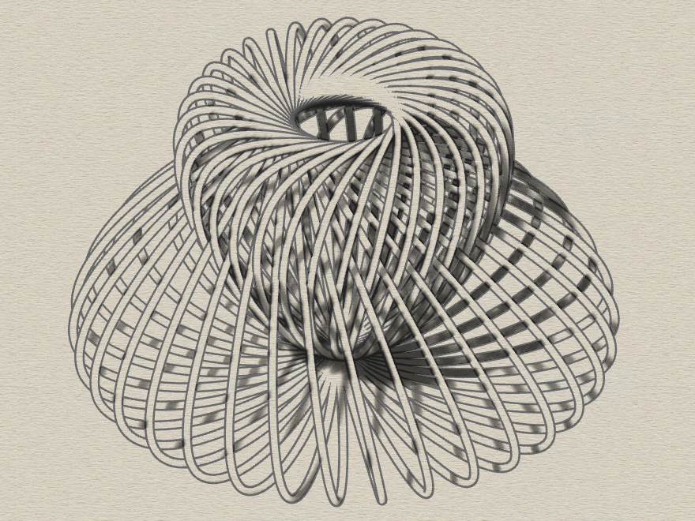
Tea light 2.
Top radius – 42 mm
Factor – (-)21
Middle radius – 75 mm
Factor – (-) 50
Bottom radius – 10 mm
Factor – 1
Count – 34
Shift – 19
Thickness – 1.5 mm

Slide 7
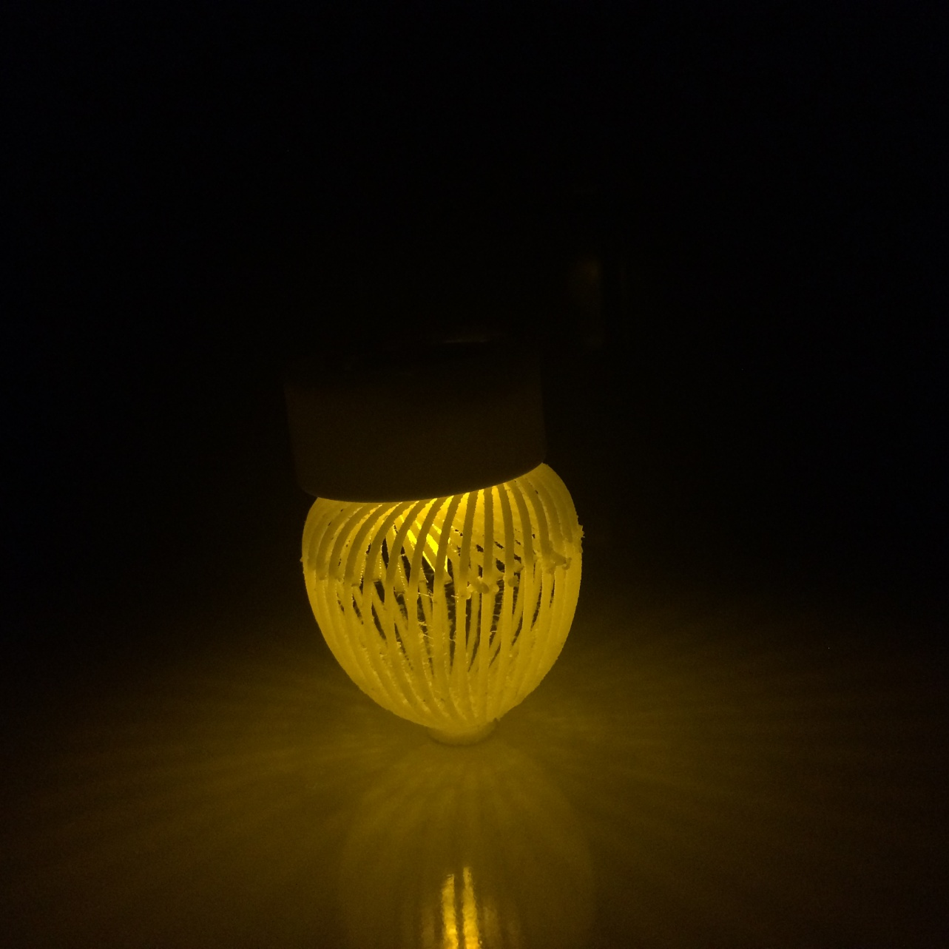
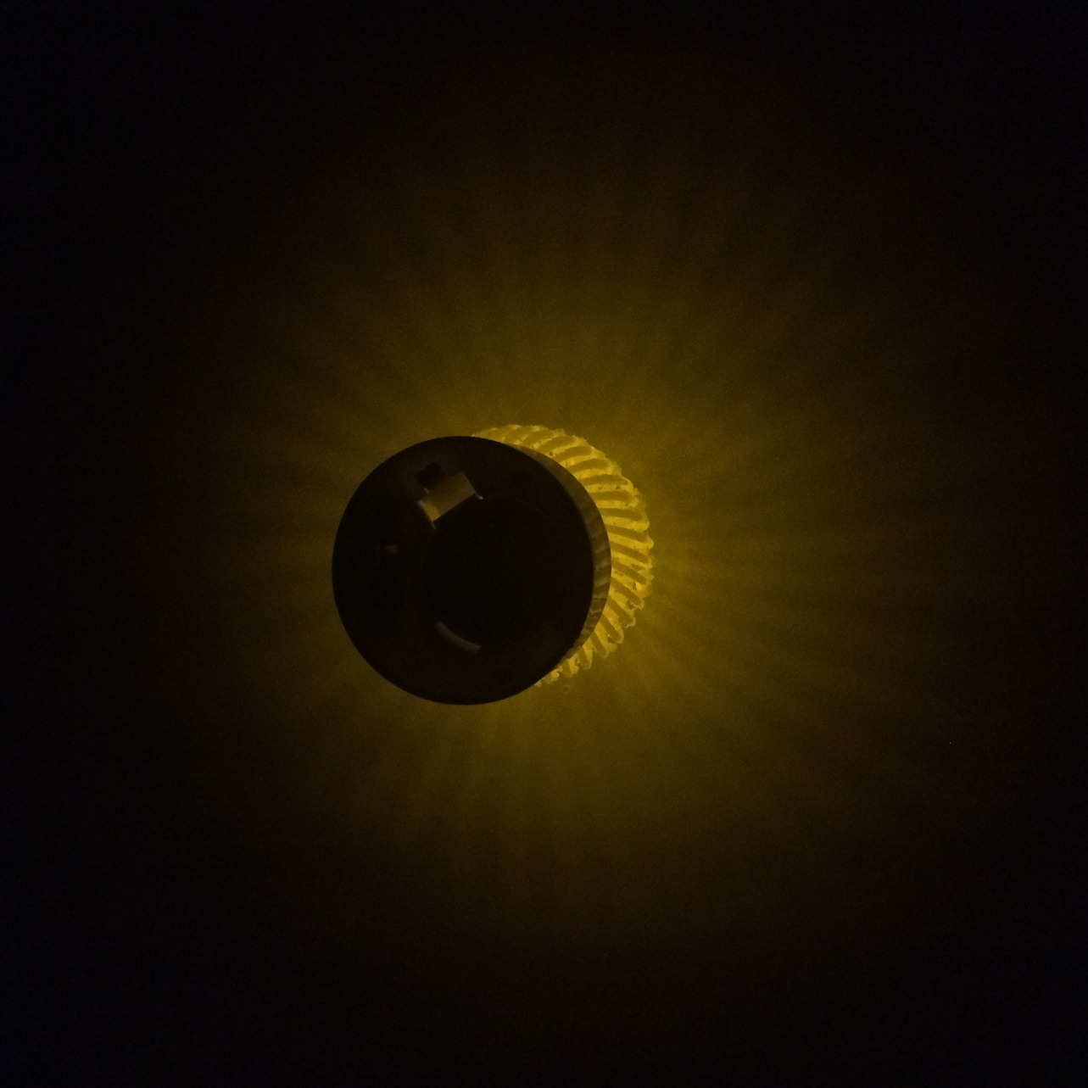
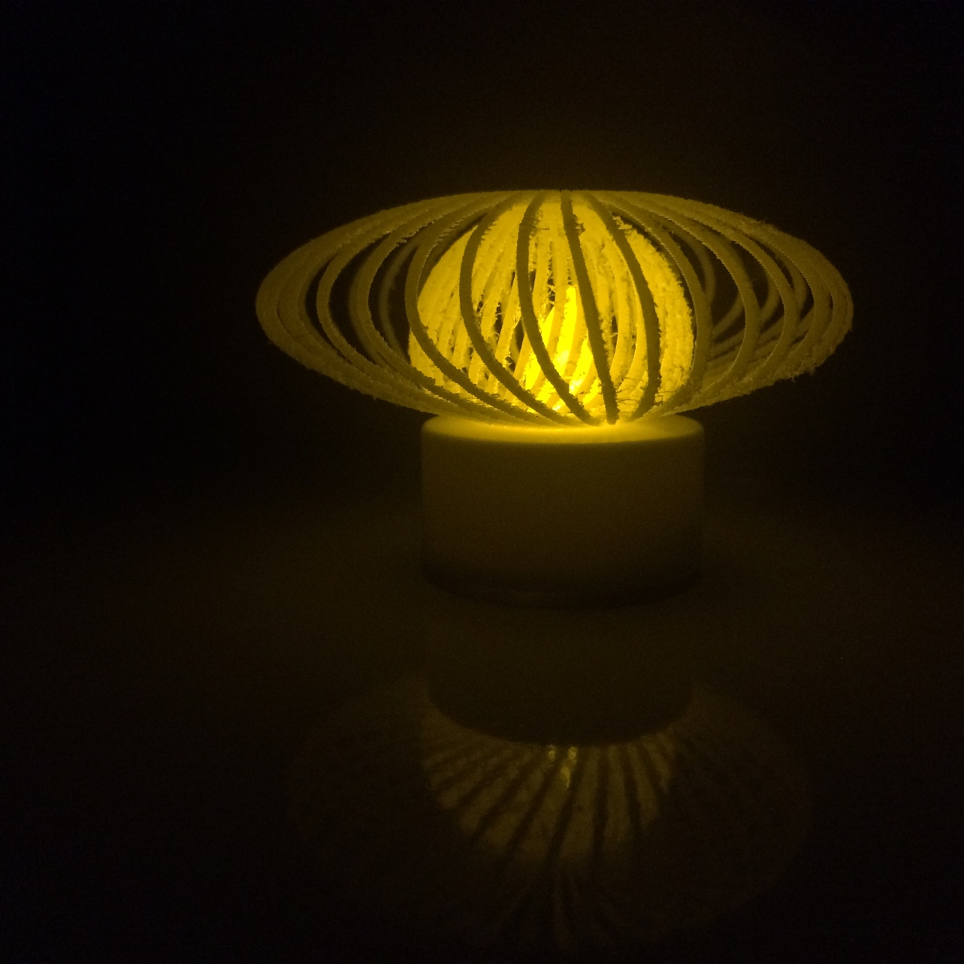

Slide 8
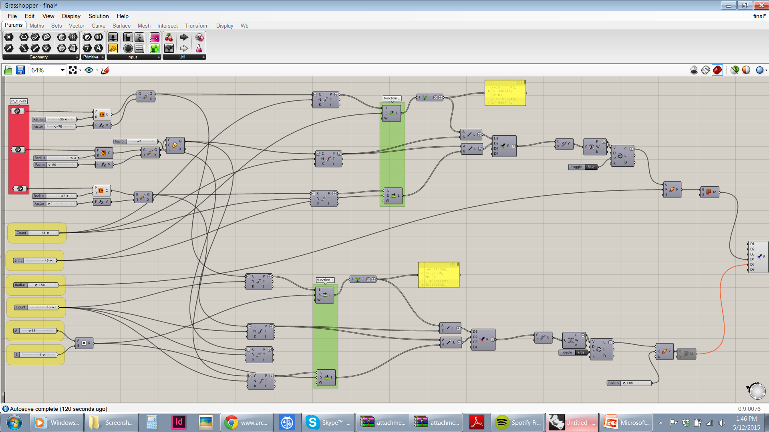
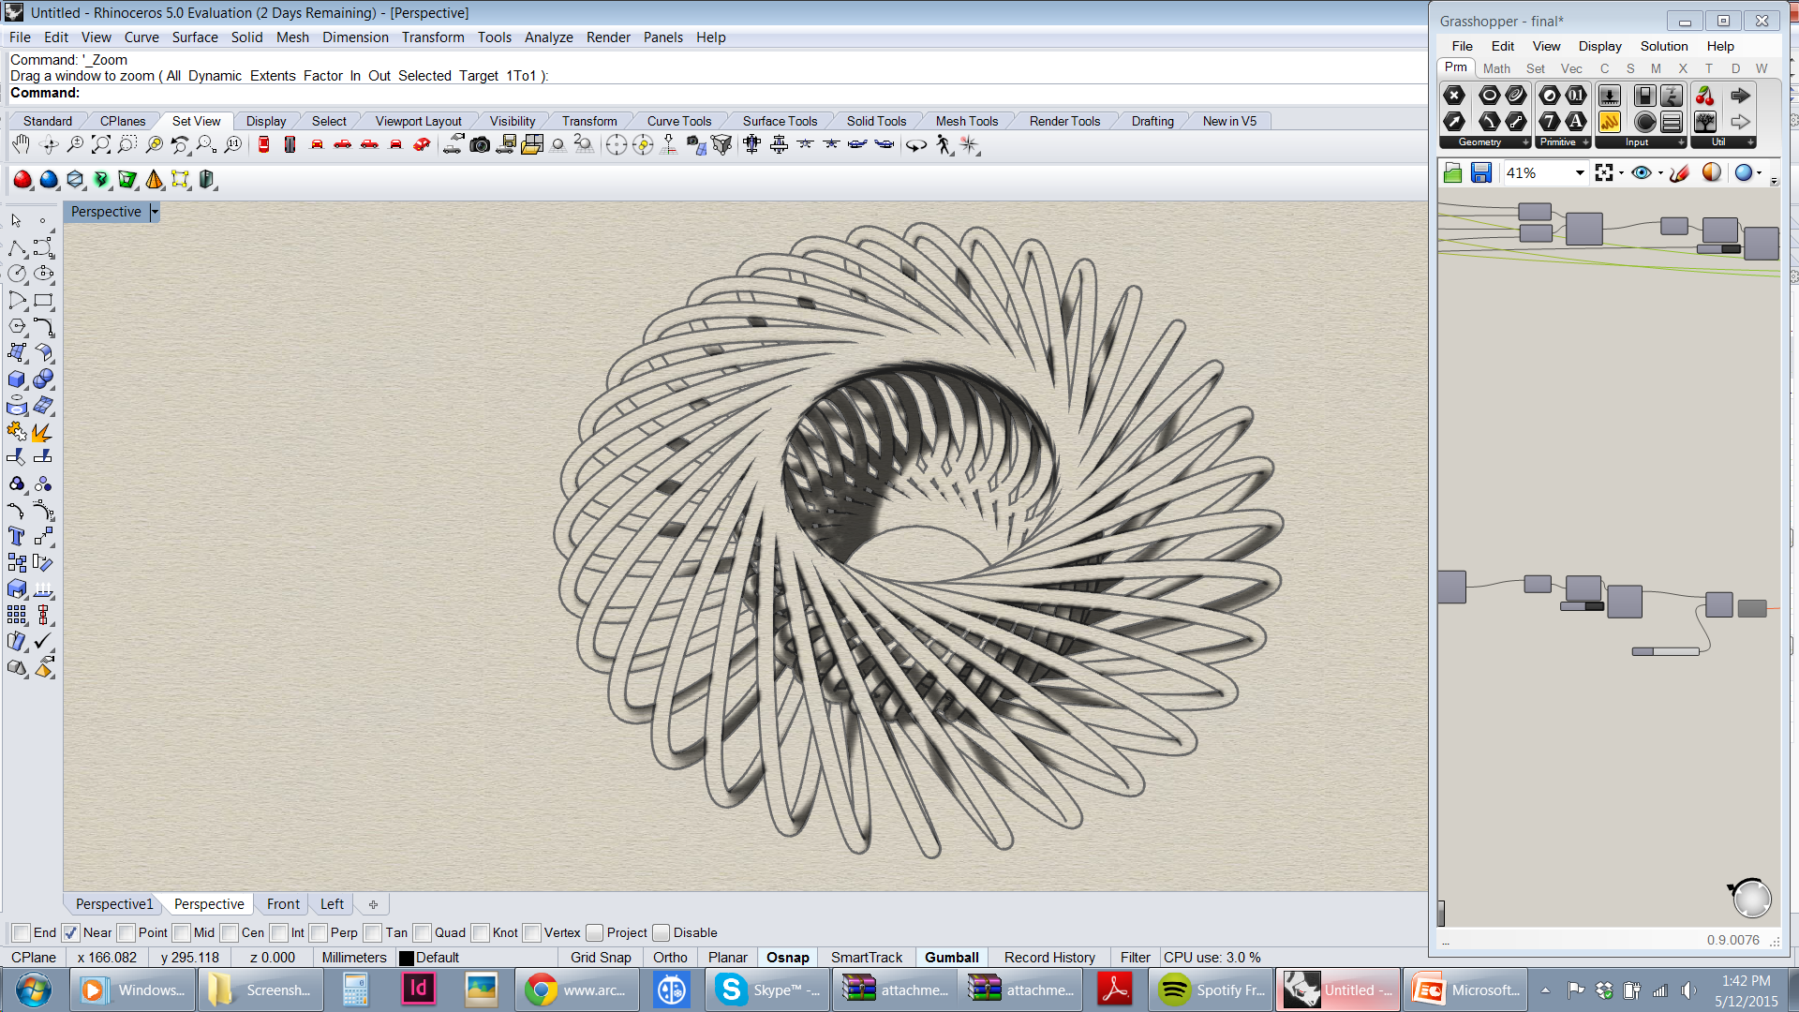
Tea light 3.
Top radius – 35 mm
Factor – (-) 70
Middle radius – 75 mm
Factor – (-)50
Bottom radius – 37 mm
Factor – 0
Count – 32
Shift – 50
Thickness – 1.5 mm

Slide 9
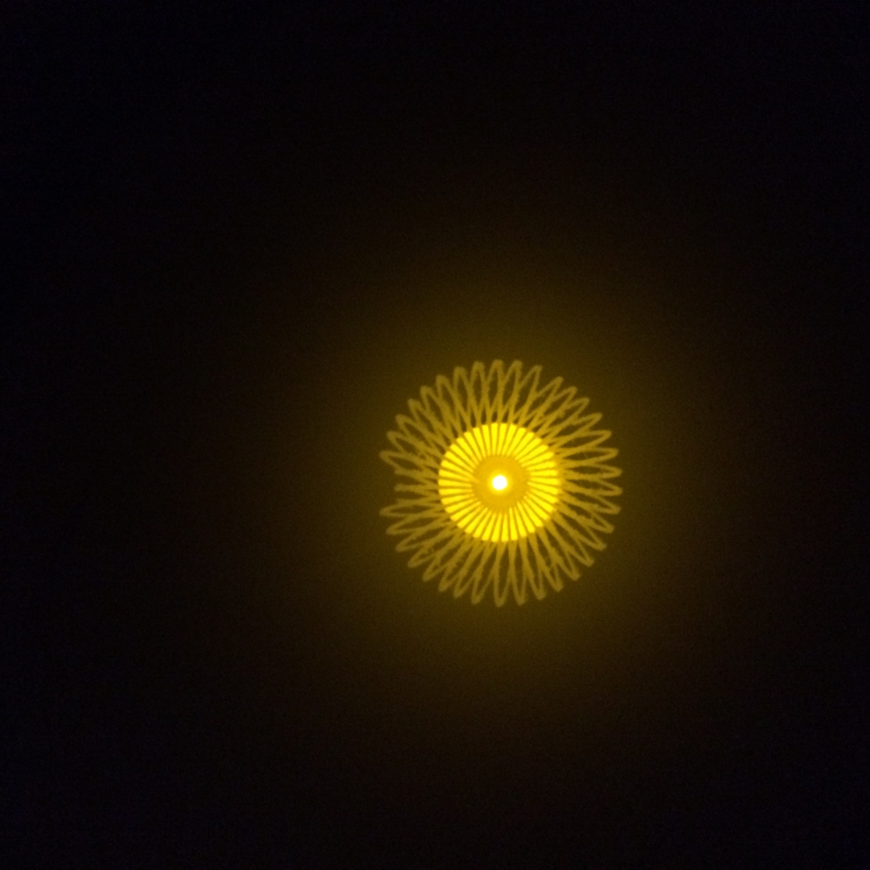

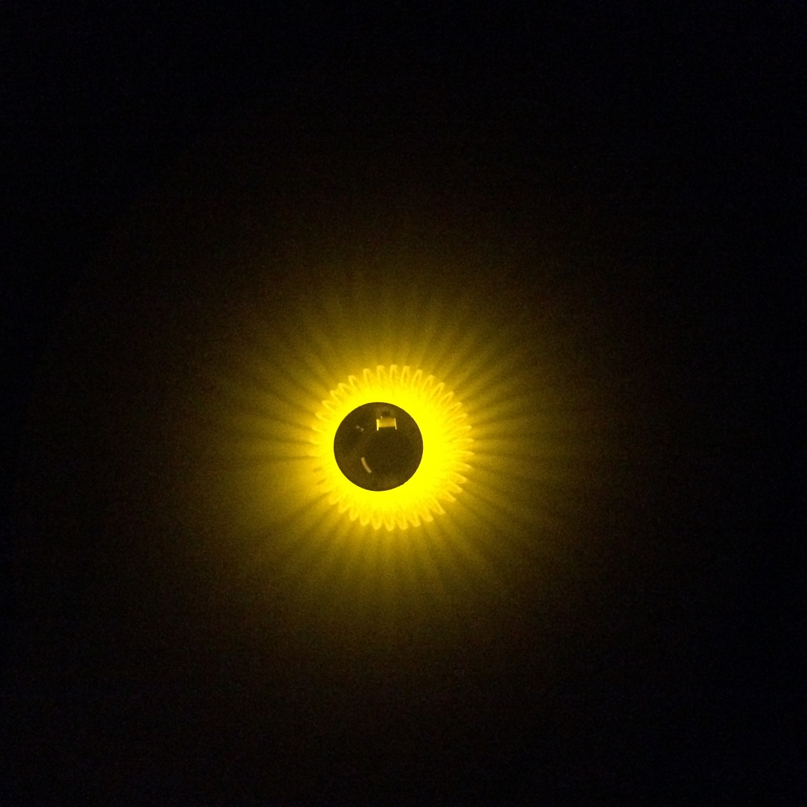

Slide 10
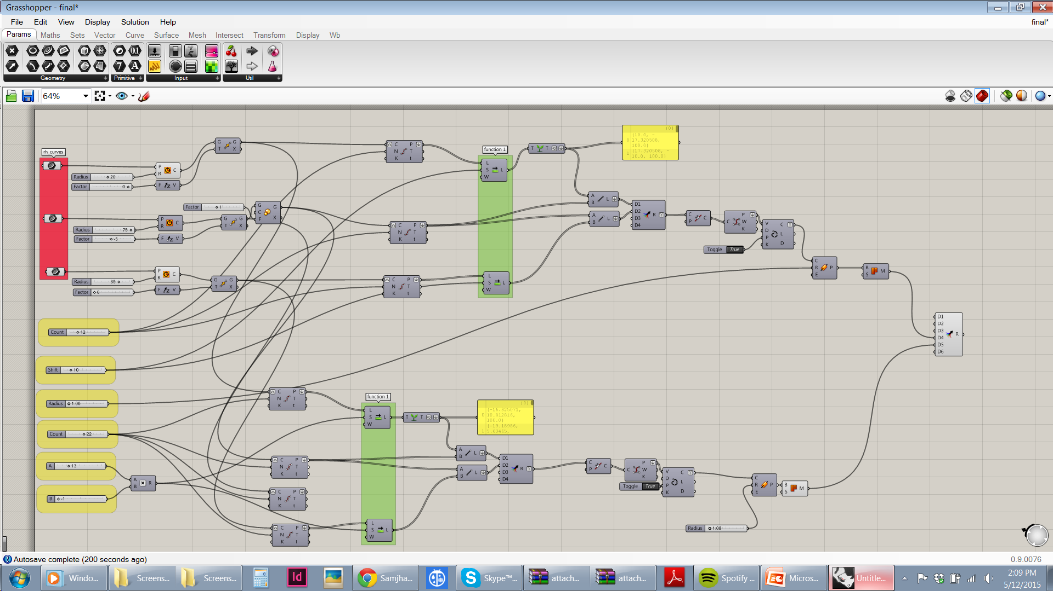
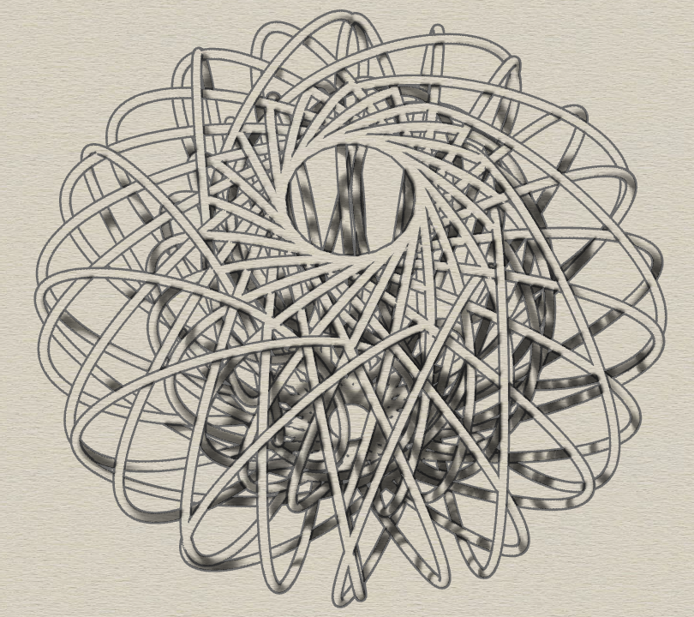
Tea light 4.
Top radius – 20 mm
Factor - 0
Middle radius – 75 mm
Factor – (-)5
Bottom radius – 35 mm
Factor – 0
Count – 12
Shift – 10
Thickness – 1 mm
Count – 22
Shift – (-)13
Thickness – 1 mm

Slide 11
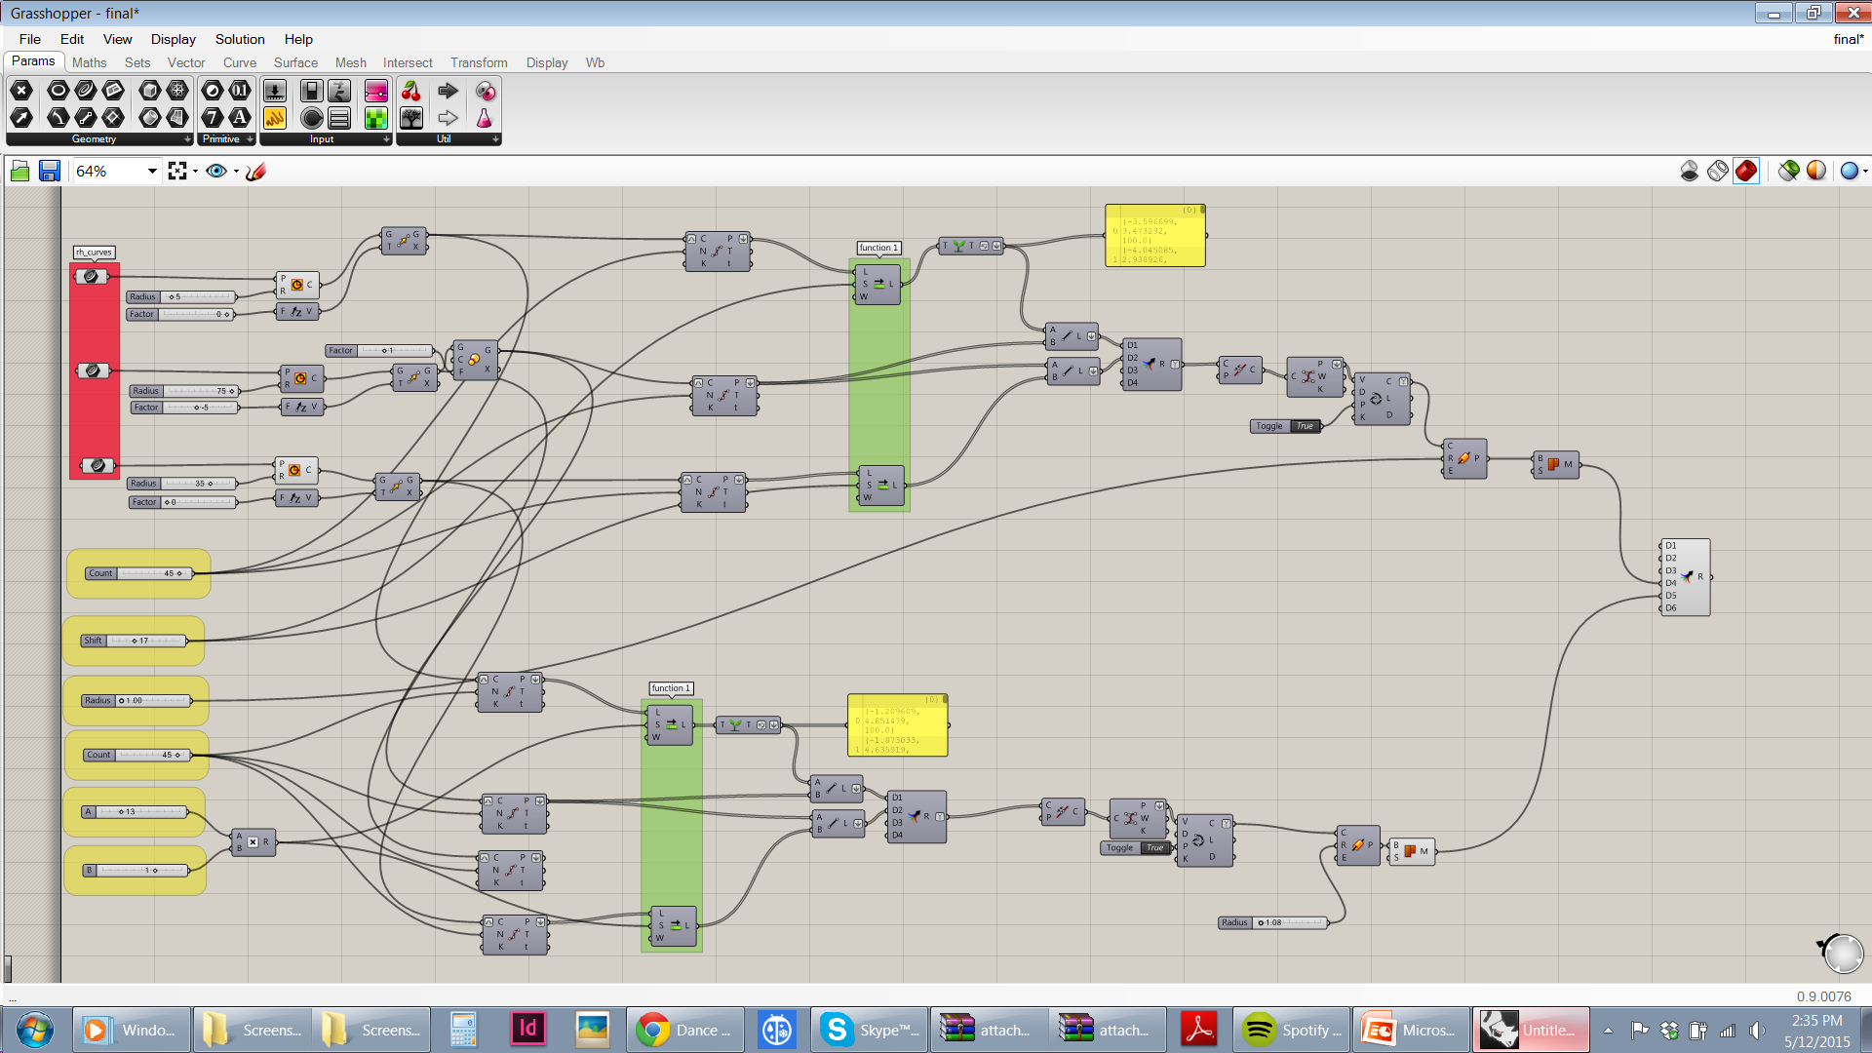
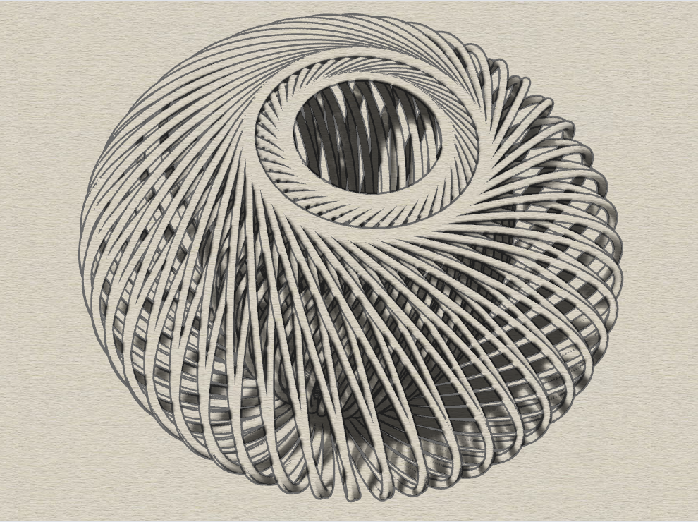
Tea light 5.
Top radius – 5 mm
Factor - 0
Middle radius – 75 mm
Factor – (-)5
Bottom radius – 35 mm
Factor – 0
Count – 45
Shift – 19
Thickness – 1 mm
Count – 45
Shift – 13
Thickness – 1 mm

Slide 12
