Slide 1
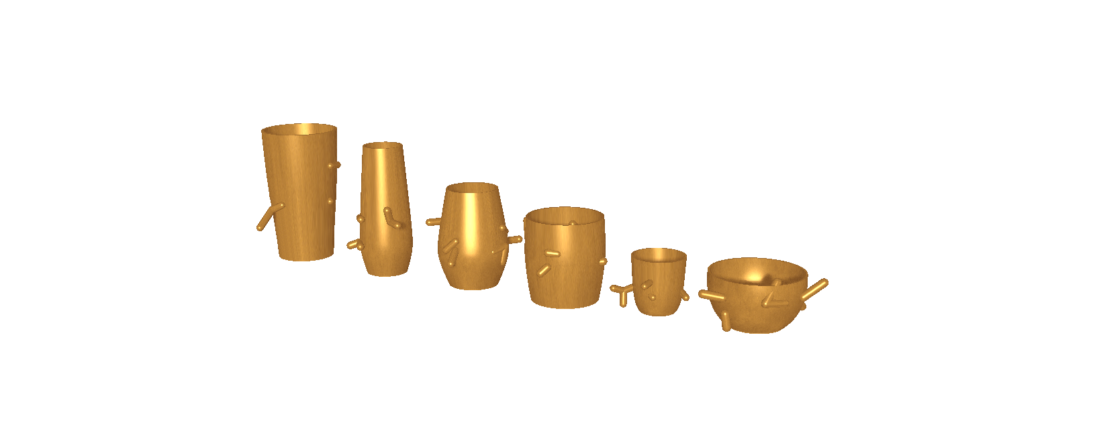
PERRIN COLLECTION
CHRISTINA JOHNSTON
PARAMETRICS
SUMMER15

Slide 2
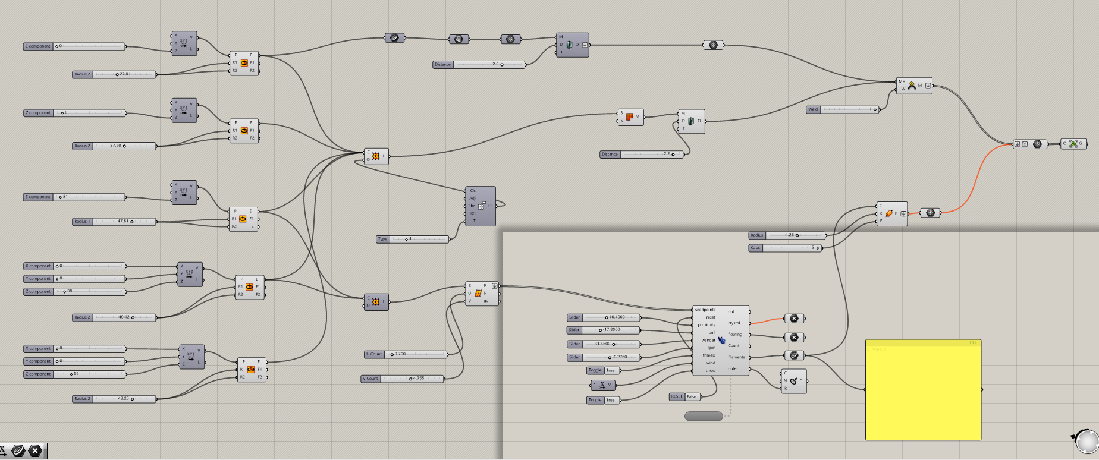
DLA VESSEL DEFINITION
DLA = DIFFUSION-LIMITED AGGREGATION
THE PROCESS WHEREBY PARTICLES UNDERGOING A RANDOM WALK DUE TO BROWNIAN MOTION CLUSTER TOGETHER TO FORM AGGREGATES OF SUCH PARTICLES
Scaling ellipses creating seed pts thickening/meshing DLA function from Brownian motion result

Slide 3
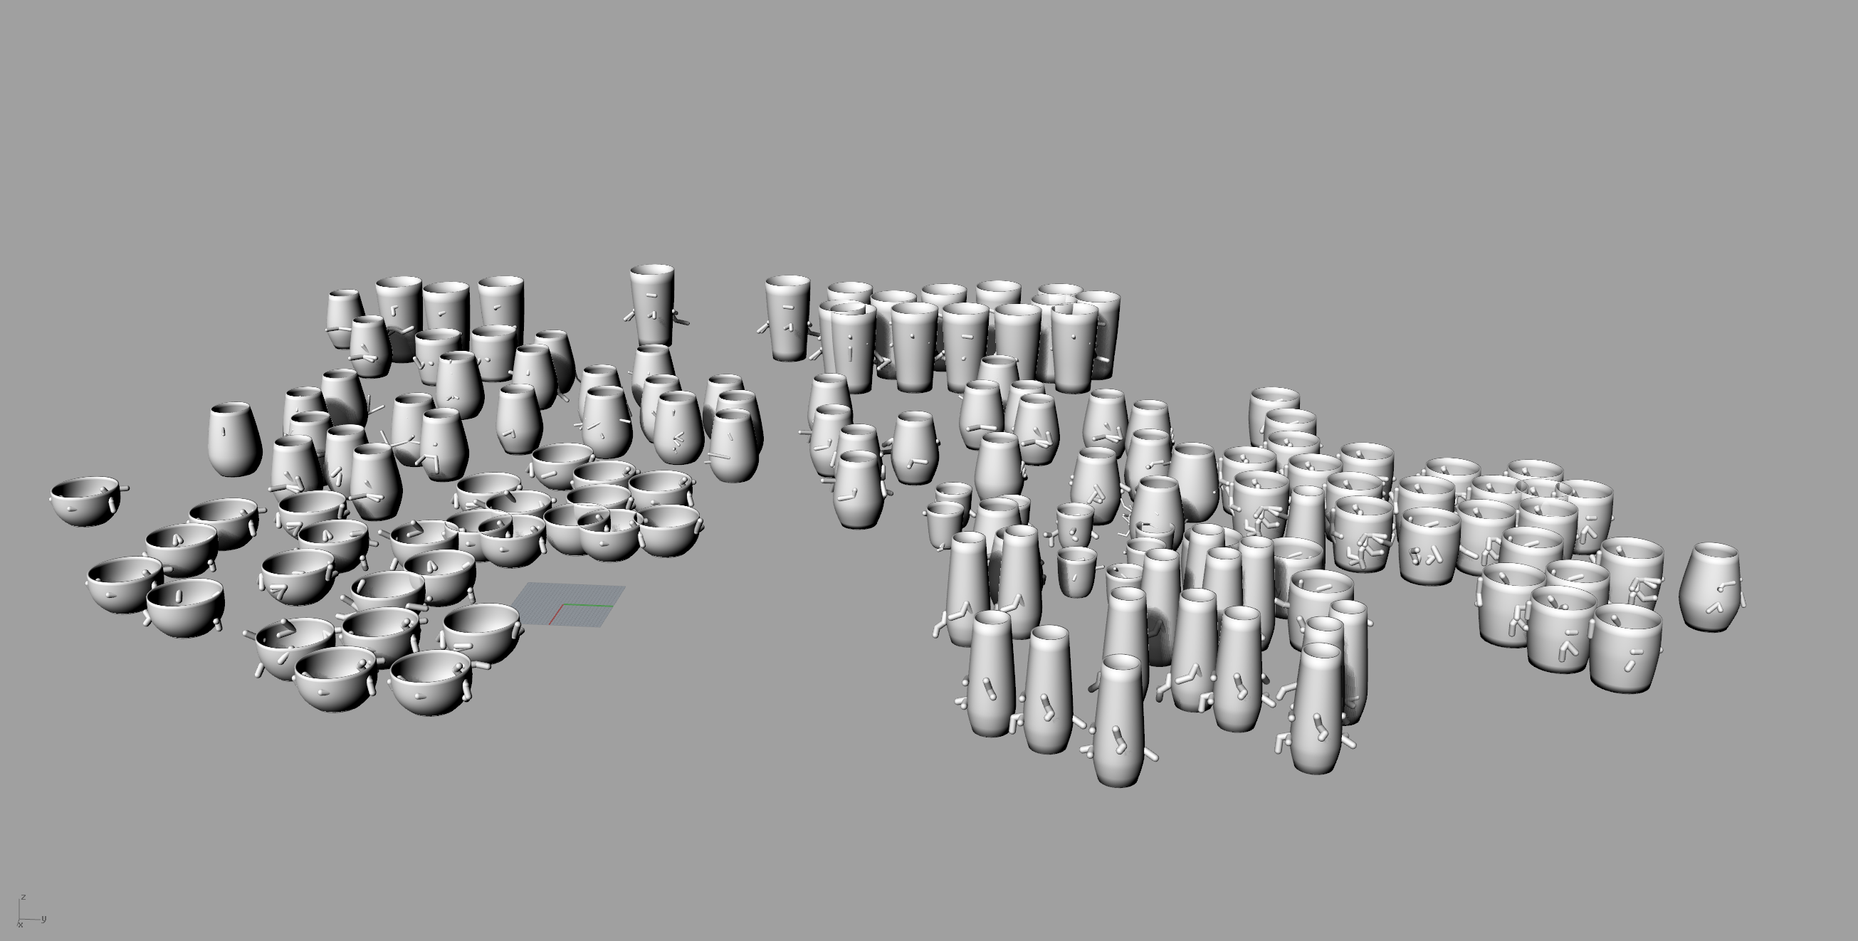
PROCESS
USING A DLA DEFINITION TO CREATE ENTIRELY UNIQUE, UNREPRODUCIBLE INSTANCES OF THE SAME THING

Slide 4

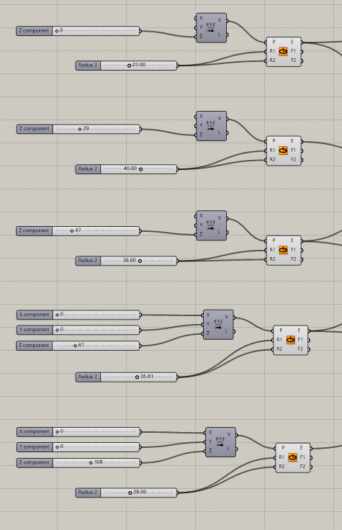
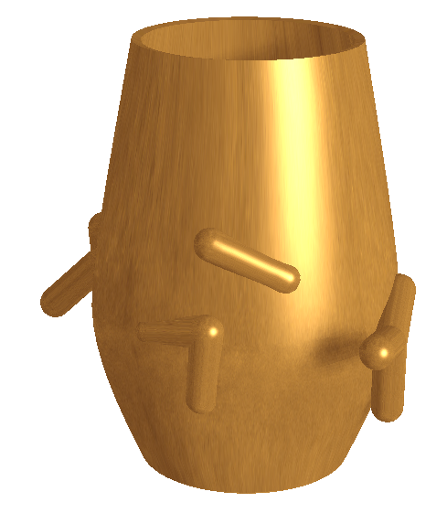
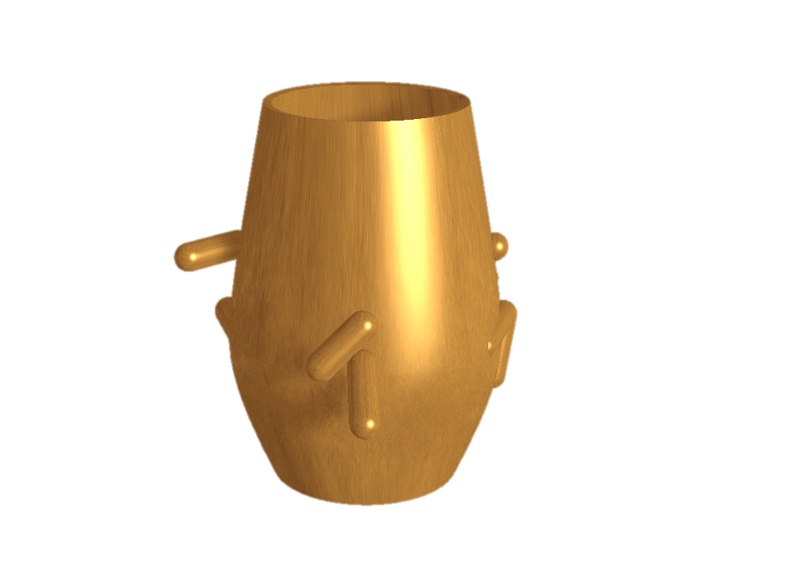
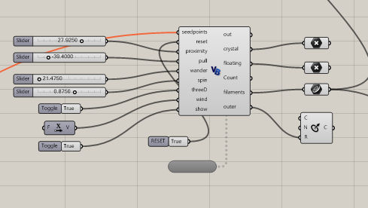
perrin SOMM
E1
Z=0, R=27
E2
Z=29, R=40
E3 (seed pt start)
Z=47, R=39
E4 (seed pt end)
Z=67, R=35.81
E5
Z=108, R=28
VESSEL
PARAMS
POSSIBLE
DLA
PARAMS

Slide 5
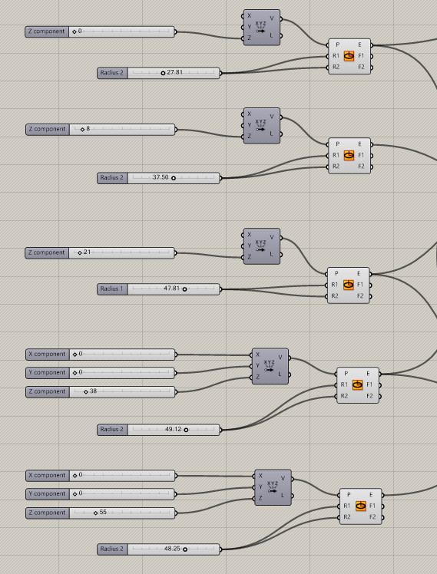
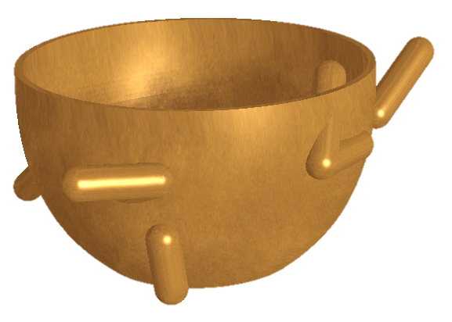
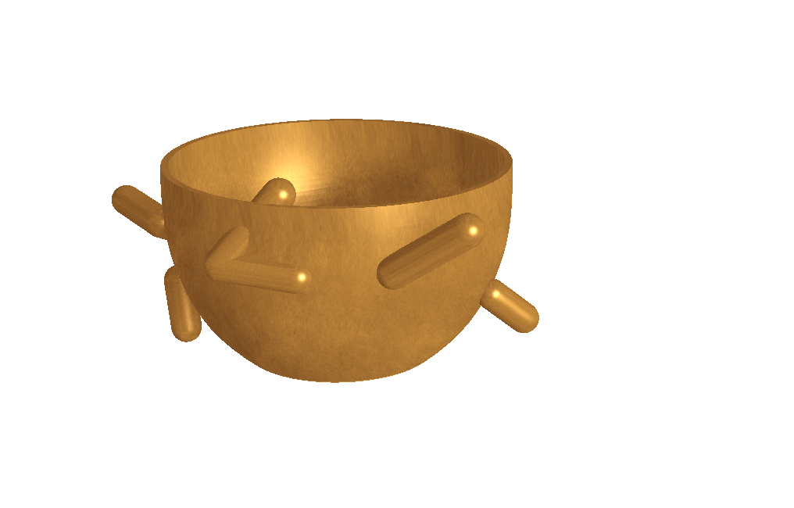
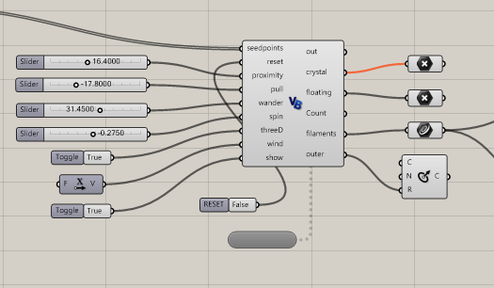
perrin SNACK
E1
Z=0, R=27.81
E2
Z=8, R=37.50
E3 (seed pt start)
Z=21, R=47.81
E4 (seed pt end)
Z=38, R=49.12
E5
Z=55, R=48.25
VESSEL
PARAMS
POSSIBLE
DLA
PARAMS

Slide 6
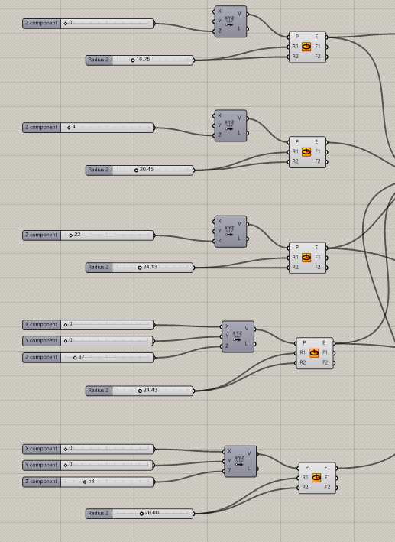
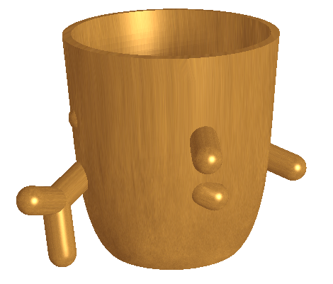
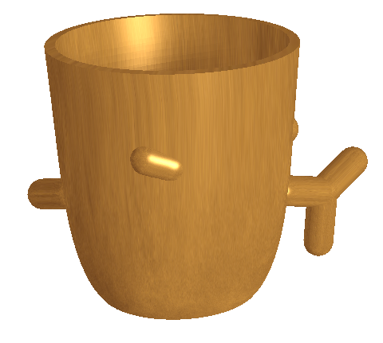
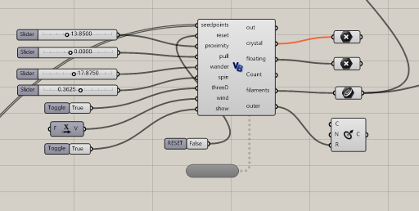
perrin SHOT
E1
Z=0, R=16.25
E2
Z=4, R=20.45
E3 (seed pt start)
Z=22, R=24.13
E4 (seed pt end)
Z=37, R=24.43
E5
Z=58, R=26.60
VESSEL
PARAMS
POSSIBLE
DLA
PARAMS

Slide 7
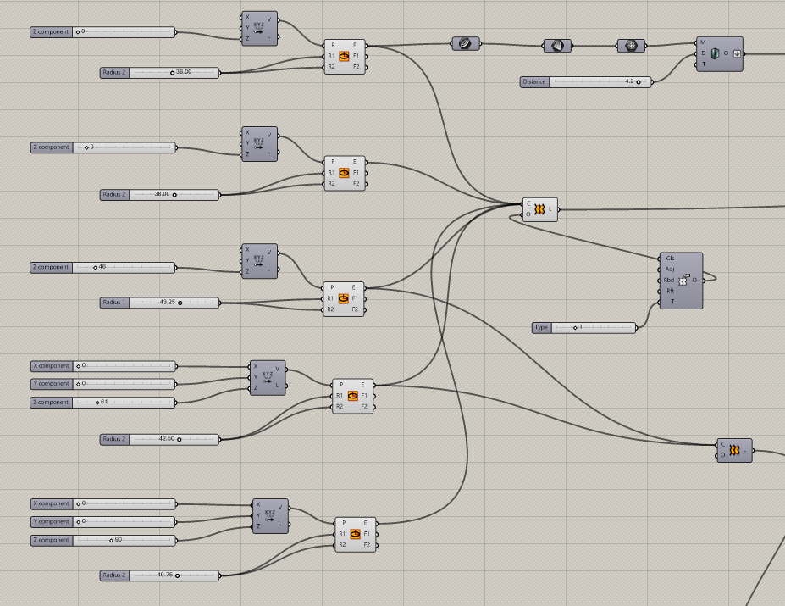
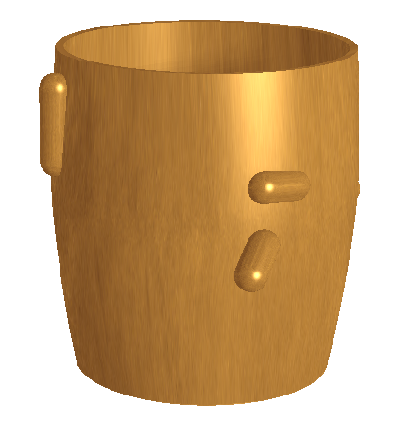
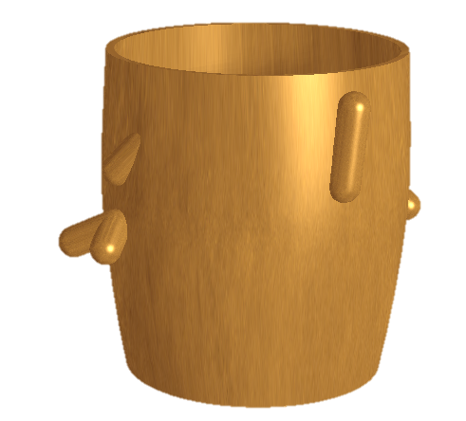
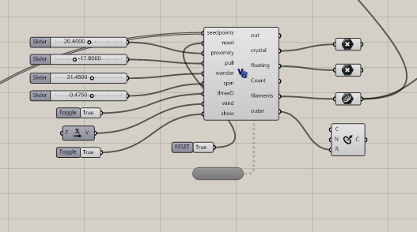
perrin LOWBALL
E1
Z=0, R=36
E2
Z=9, R=38
E3 (seed pt start)
Z=46, R=43.25
E4 (seed pt end)
Z=61, R=42.5
E5
Z=90, R=40.25
VESSEL
PARAMS
POSSIBLE
DLA
PARAMS

Slide 8
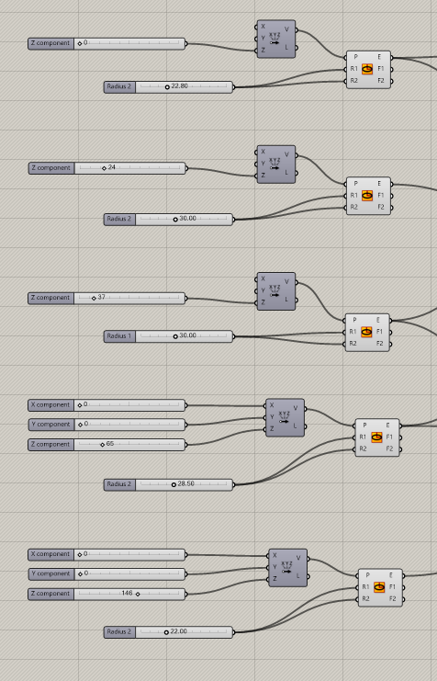
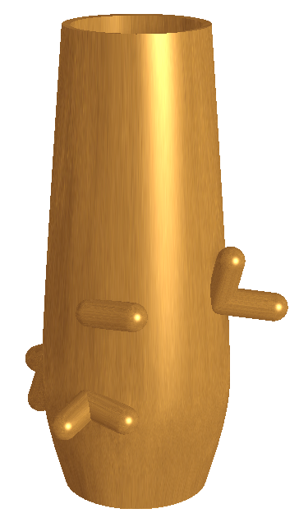
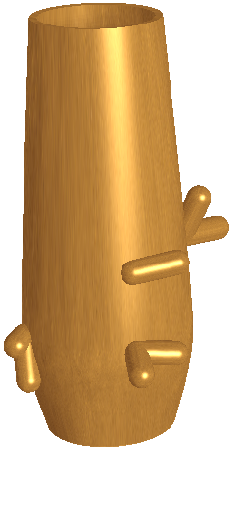
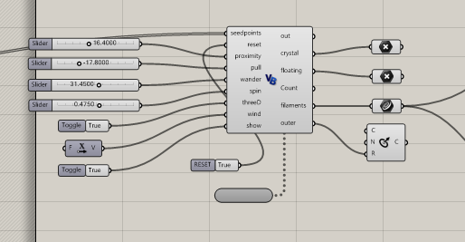
perrin BUBBLY
E1
Z=0, R=22.8
E2
Z=24, R=30
E3 (seed pt start)
Z=37, R=30
E4 (seed pt end)
Z=65, R=28.5
E5
Z=146, R=22
VESSEL
PARAMS
POSSIBLE
DLA
PARAMS

Slide 9
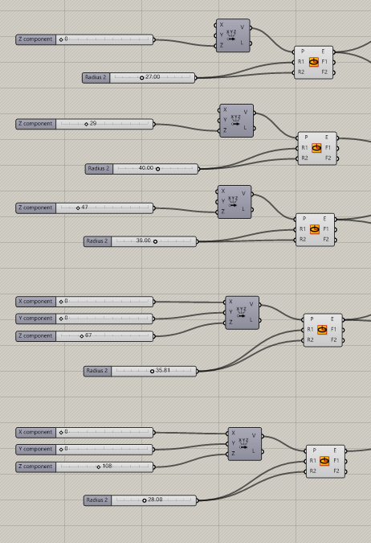
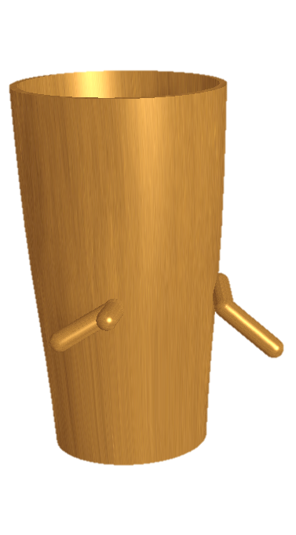
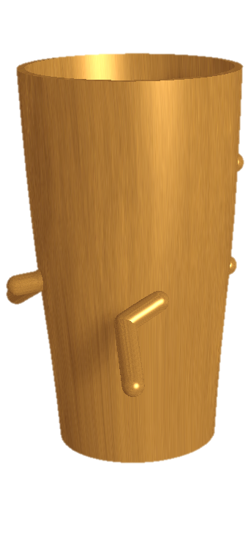
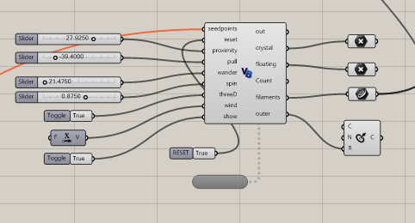
perrin PINT
E1
Z=0, R=27
E2
Z=29, R=40
E3 (seed pt start)
Z=47, R=39
E4 (seed pt end)
Z=67, R=35.81
E5
Z=108, R=28
VESSEL
PARAMS
POSSIBLE
DLA
PARAMS

Slide 10
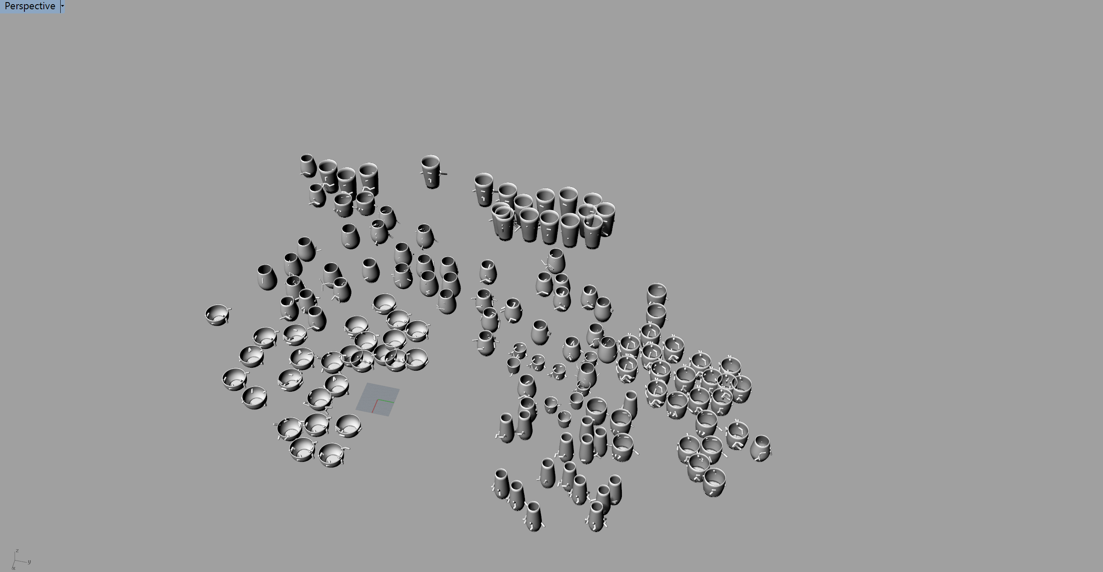
THE END THANK YOU

