Slide 1
Kokedama Planters

Slide 2
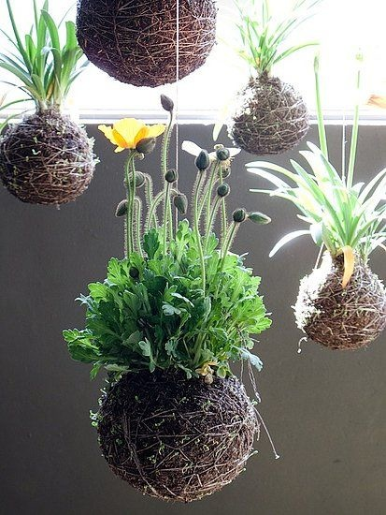
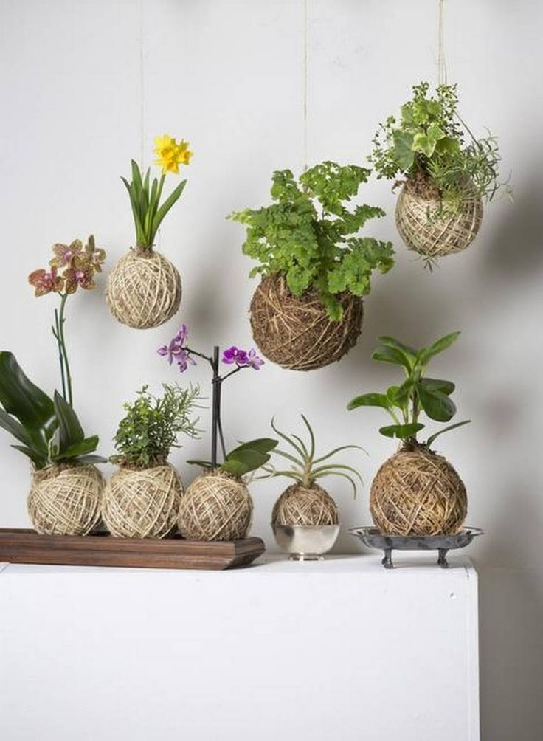
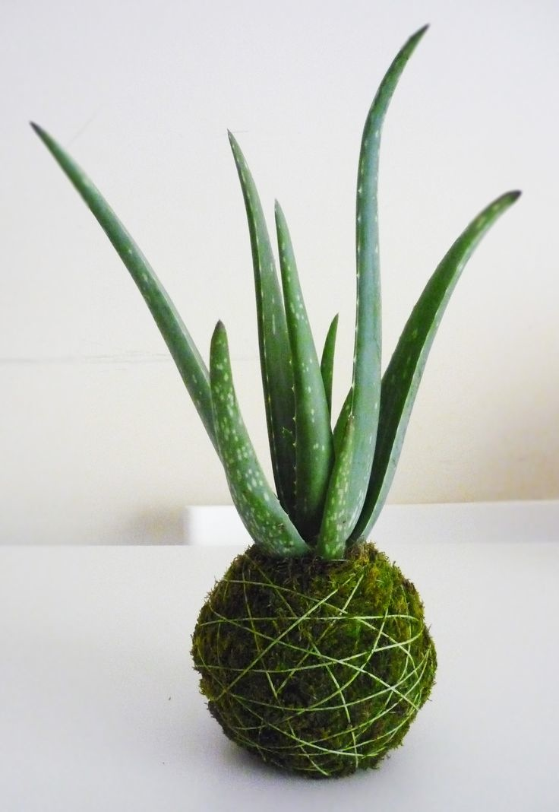

Slide 3
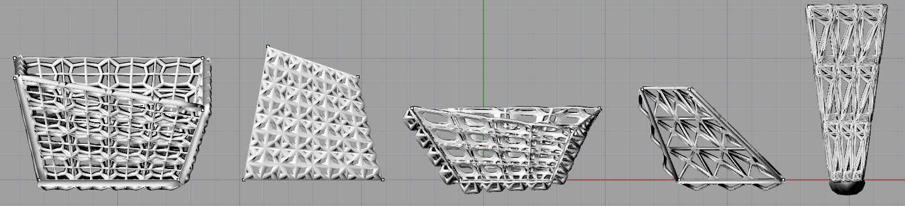
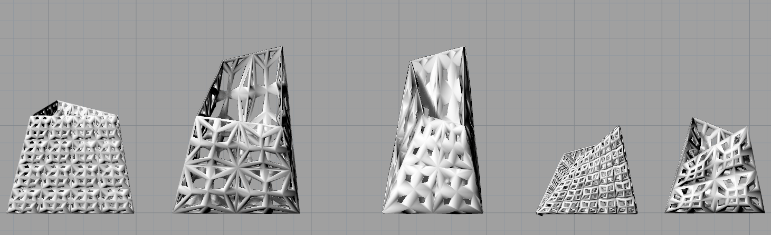

Slide 4
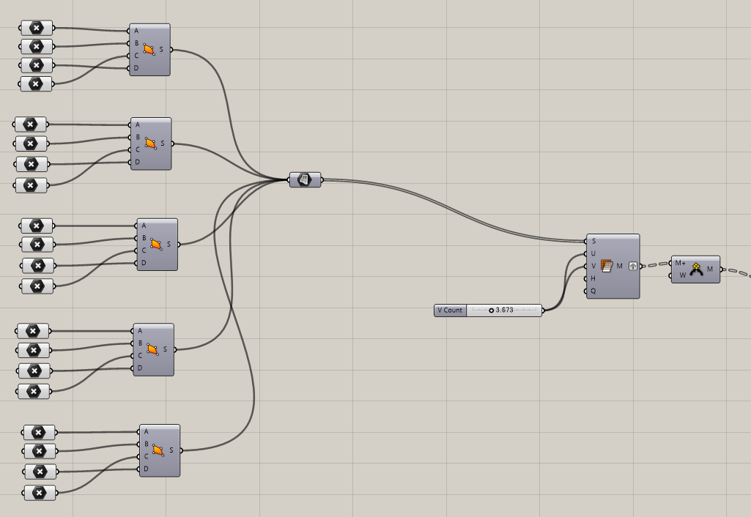
To create the 5 surfaces of the object:
Create points in Rhino
Select points in grasshopper to create a surface.
Join the surface to create one surface.
Mesh surface to create a mesh of desired grid size.
Weld the mesh together.

Slide 5
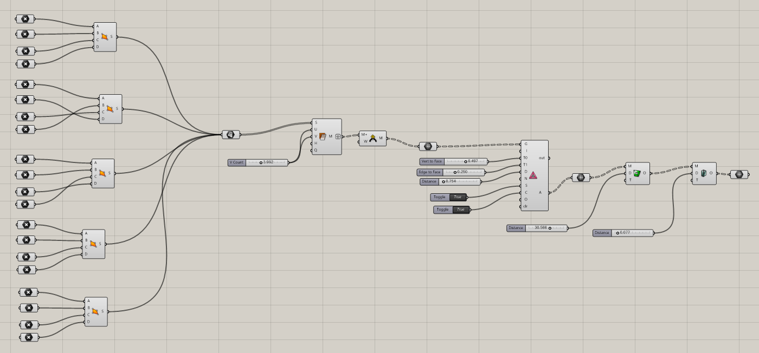

Slide 6
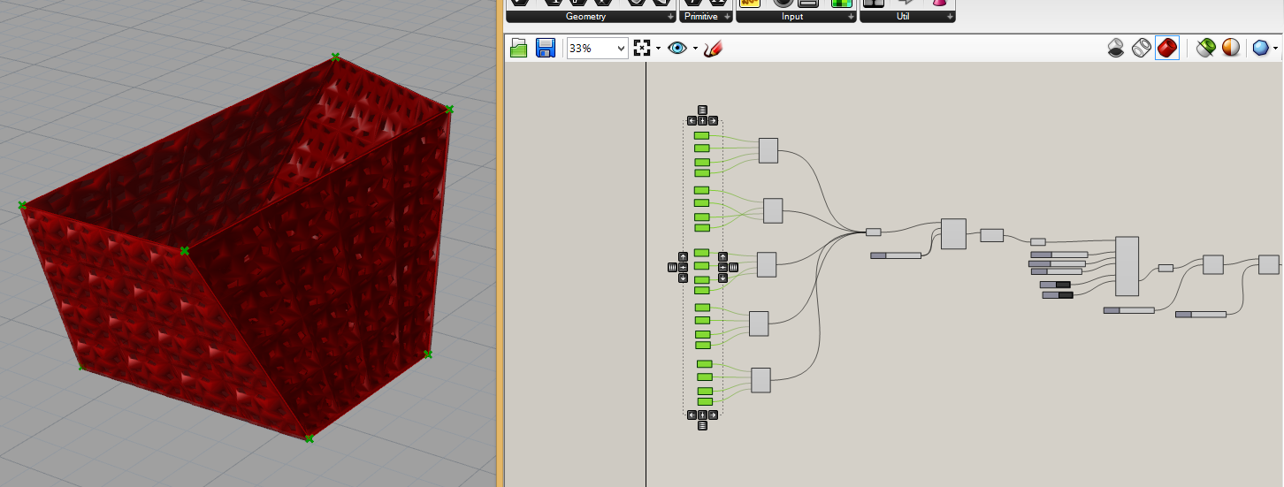

Slide 7
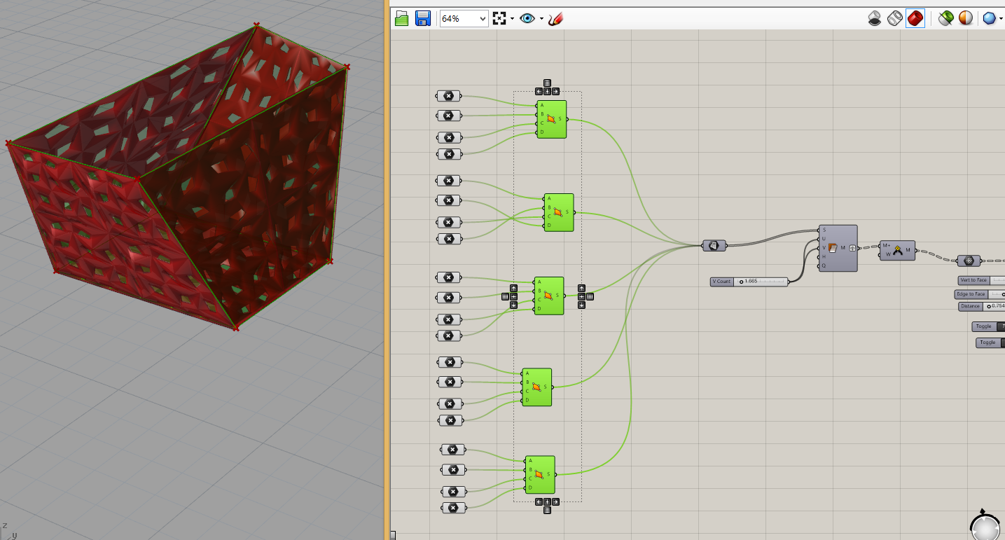

Slide 8
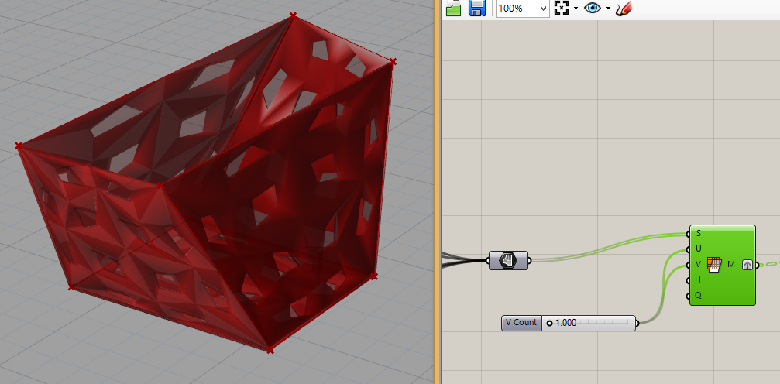
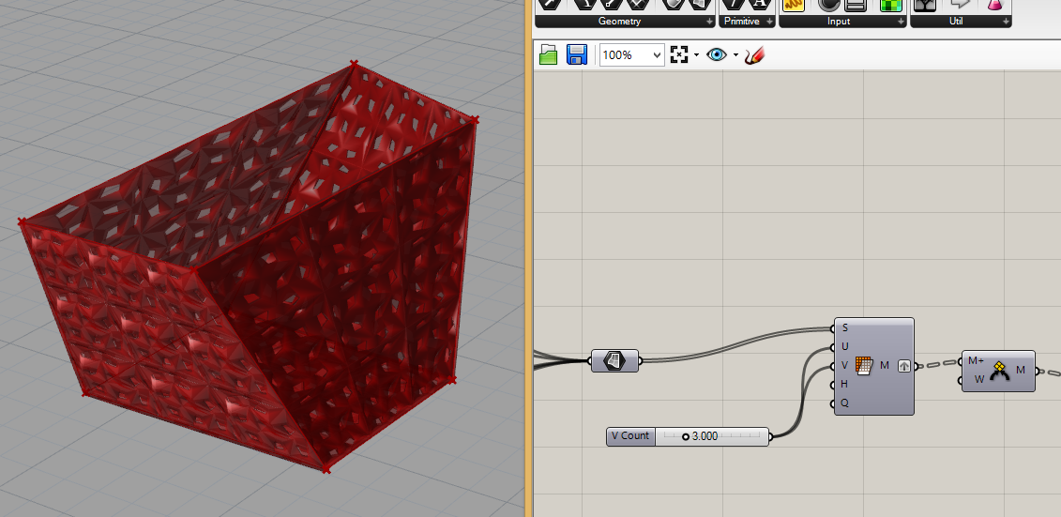

Slide 9
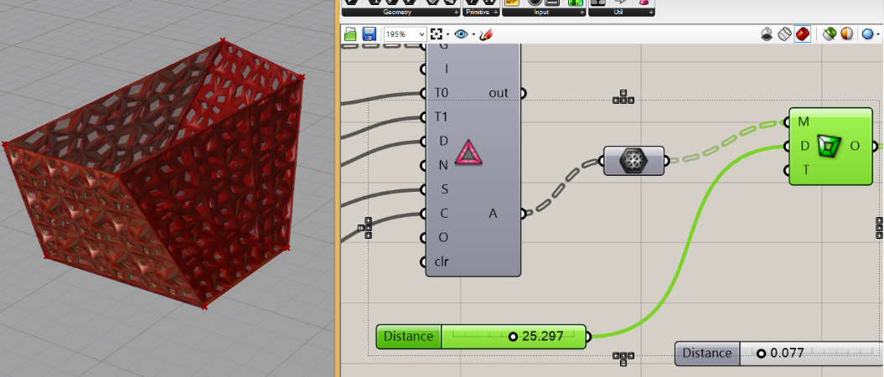
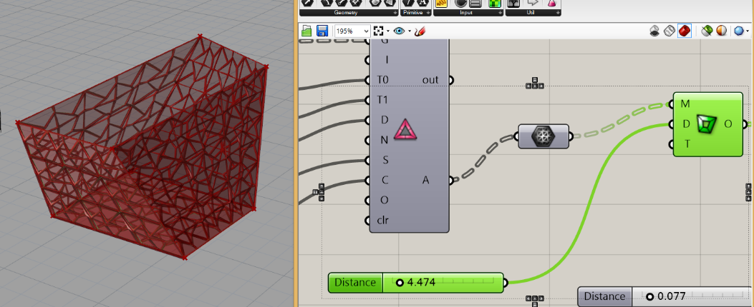

Slide 10
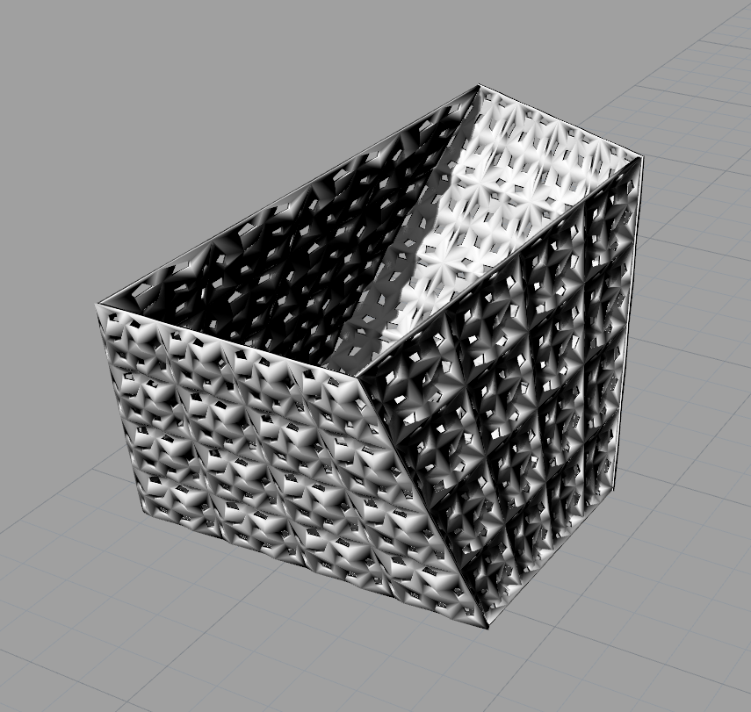
Surface mesh
U: 2.5
V: 2.5
Frame +1
Vertex to face: 0.6
Edge to face: 0.6
Distance: 1.6
Weaverbird picture Frame
Distance: 25
Weaverbird mesh thickness
Distance: 0.04

Slide 11
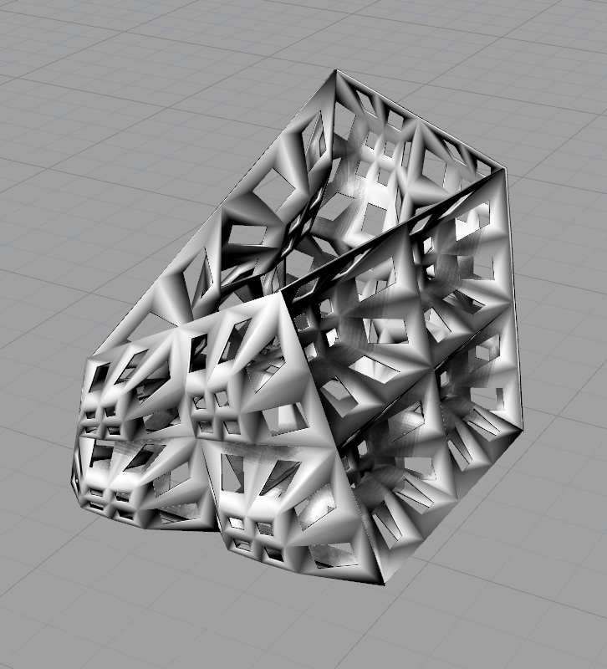
Surface mesh
U: 5.3
V: 5.3
Frame +1
Vertex to face: 0.1
Edge to face: 0.25
Distance: 3
Weaverbird picture Frame
Distance: 15
Weaverbird mesh thickness
Distance: 0.08

Slide 12
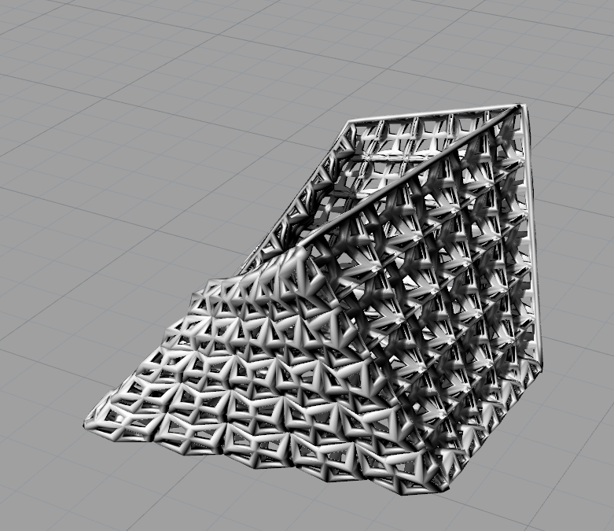
Surface mesh
U: 1.8
V: 1.8
Frame +1
Vertex to face: 0.00
Edge to face: 0.24
Distance: 3.2
Weaverbird picture Frame
Distance: 34
Weaverbird mesh thickness
Distance: 0.09

Slide 13
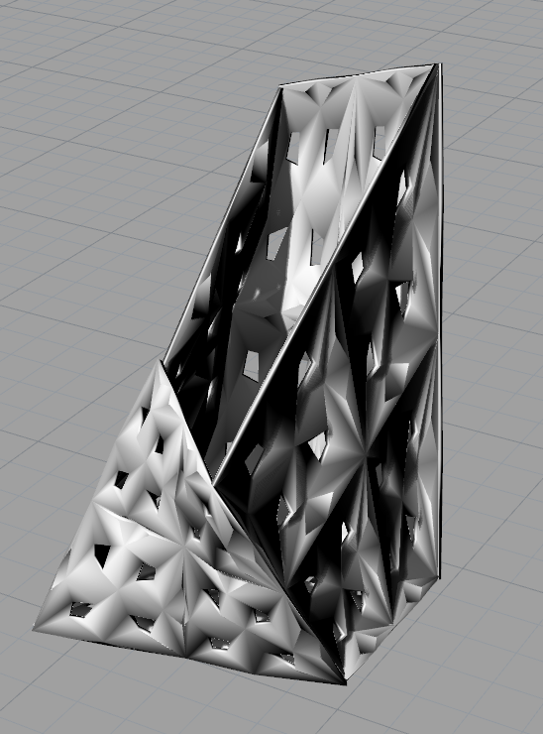
Surface mesh
U: 2
V: 2
Frame +1
Vertex to face: 0.00
Edge to face: 0.4
Distance: 1.2
Weaverbird picture Frame
Distance: 17
Weaverbird mesh thickness
Distance: 0.07

Slide 14
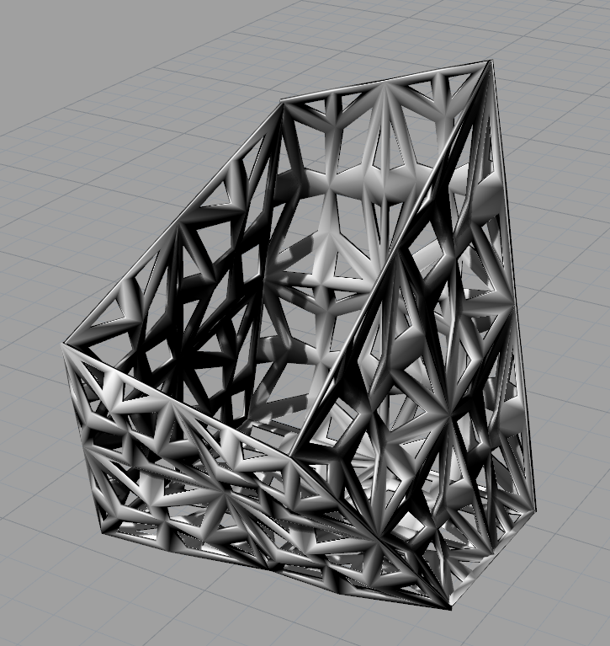
Surface mesh
U: 3
V: 3
Frame +1
Vertex to face: 0.6
Edge to face: 0.25
Distance: 0.75
Weaverbird picture Frame
Distance: 26
Weaverbird mesh thickness
Distance: 0.07

