Slide 1
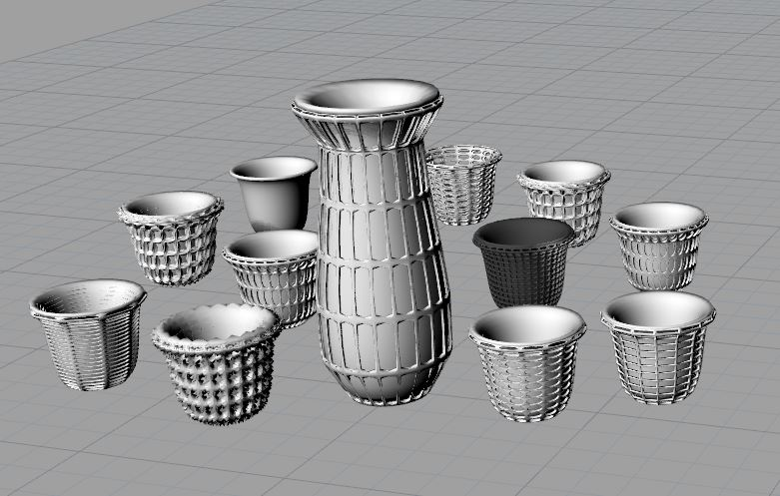
Creating a Parametric Sake Set
Lilia Levine
INT731-02

Slide 2
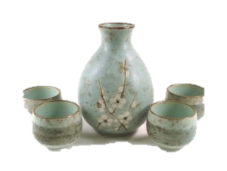
Inspiration

Slide 3
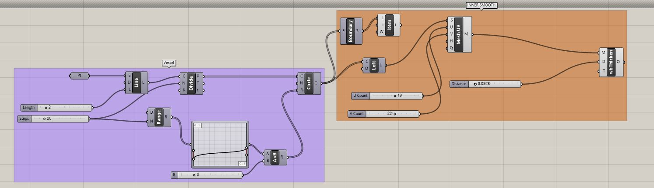
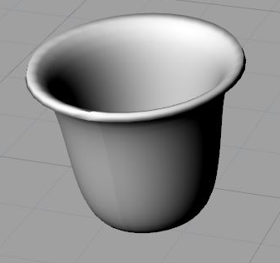
Creating the Base
Length = 2”
Steps = 20
Height = 3”
U Count = 19
V Count = 22
Thickness = .0928 to be modified for printing

Slide 4
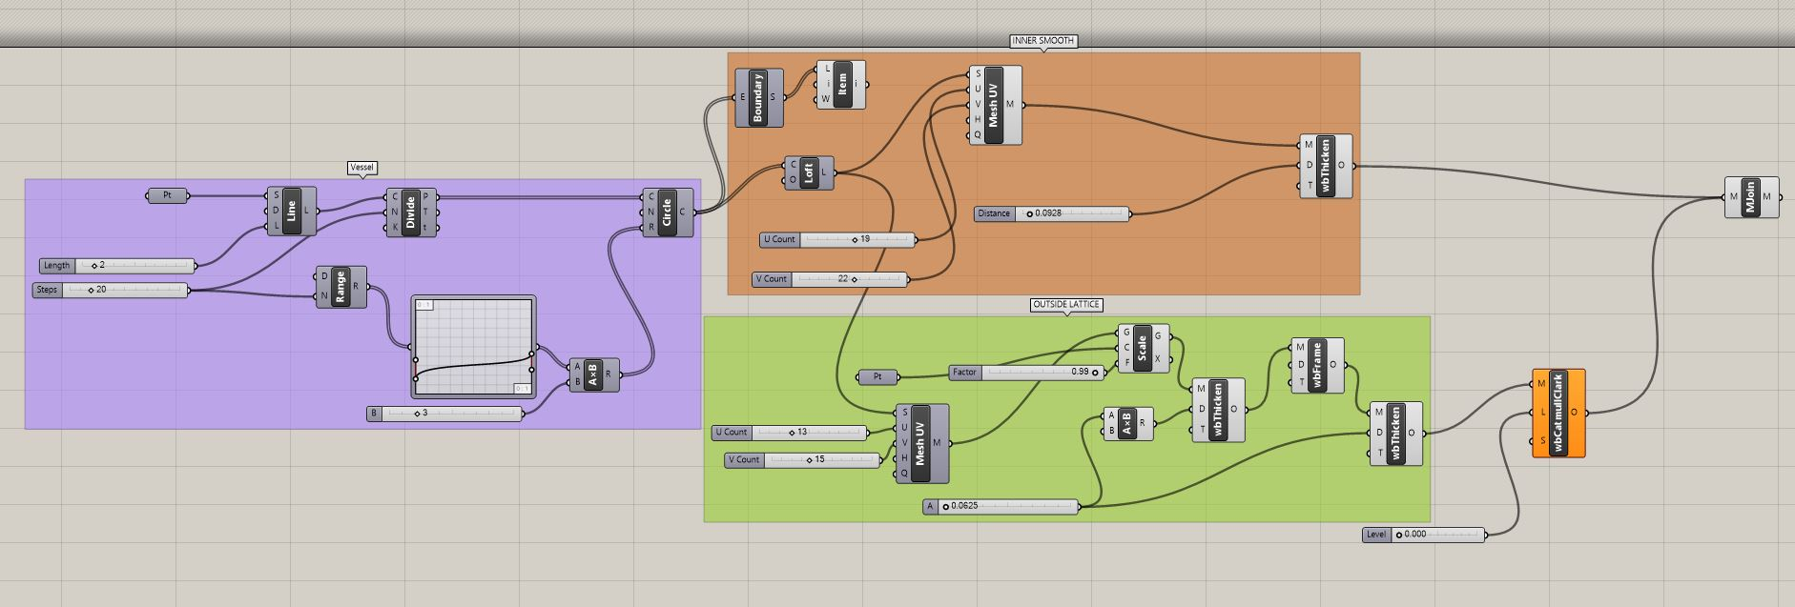
Adding the Exterior Lattice Mesh
U Count = 13
V Count = 13
Offset 99% (.99) from inner cup
Thickness at .0625 to be modified for printing

Slide 5
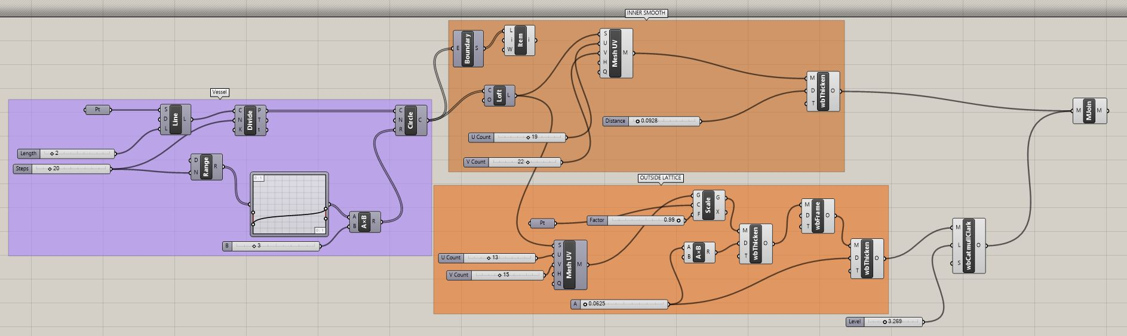
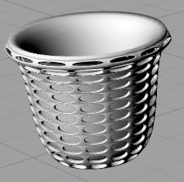
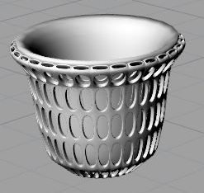
Adjusting the Apertures
Catmull-Clark Level 3.268
U count = 13
V count = 13
Catmull-Clark Level 3.268
U count = 8
V count = 18
Applying the Catmull-Clark Mesh
Adjusting the number of mesh divisions

Slide 6
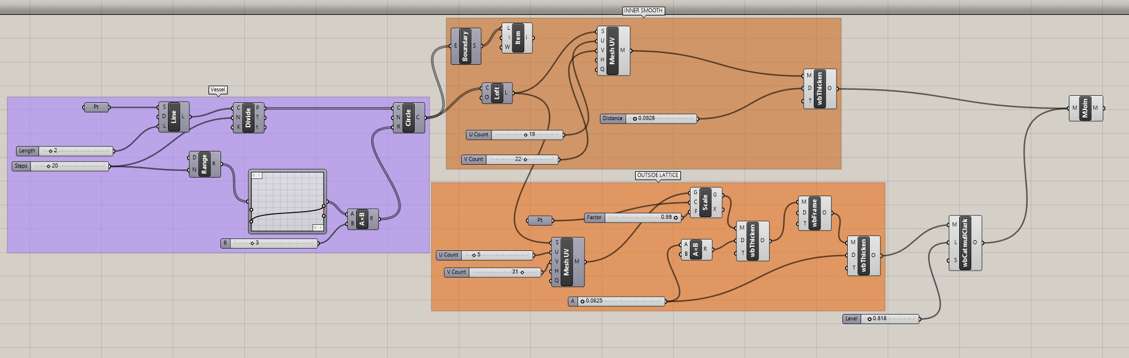
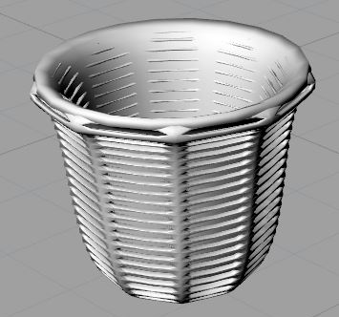
Adjusting the Apertures
Catmull-Clark Level .818
U count = 5
V count = 21
Adjusting the number of mesh divisions and extents of Catmull-Clark

Slide 7
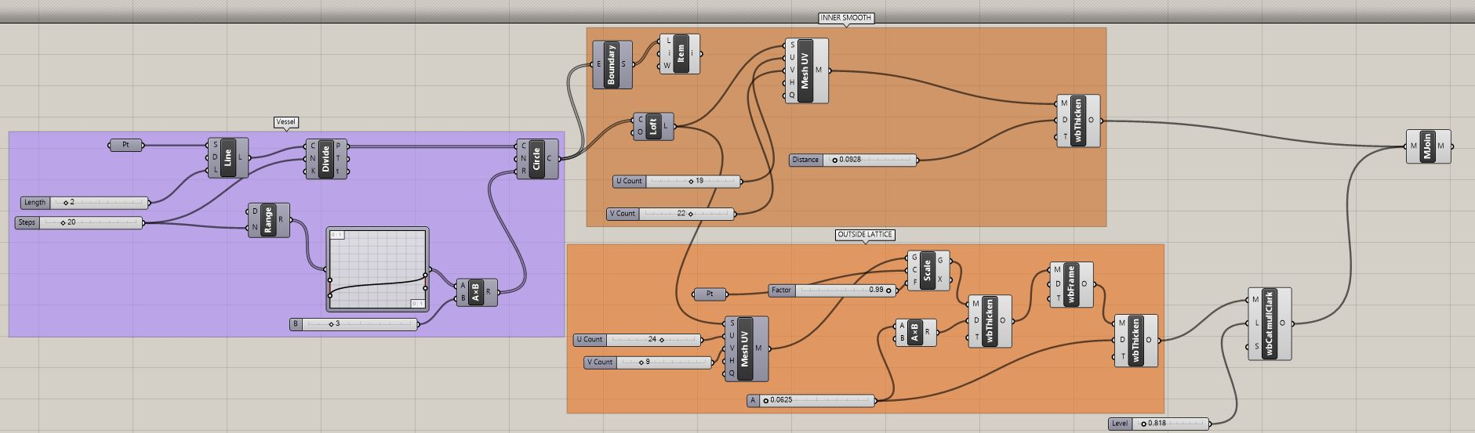
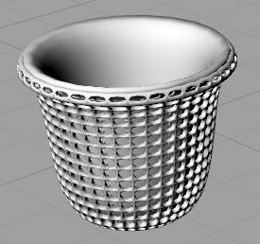
Adjusting the Apertures
Catmull-Clark Level .818
U count = 24
V count = 5
Adjusting the number of mesh divisions and extents of Catmull-Clark

Slide 8
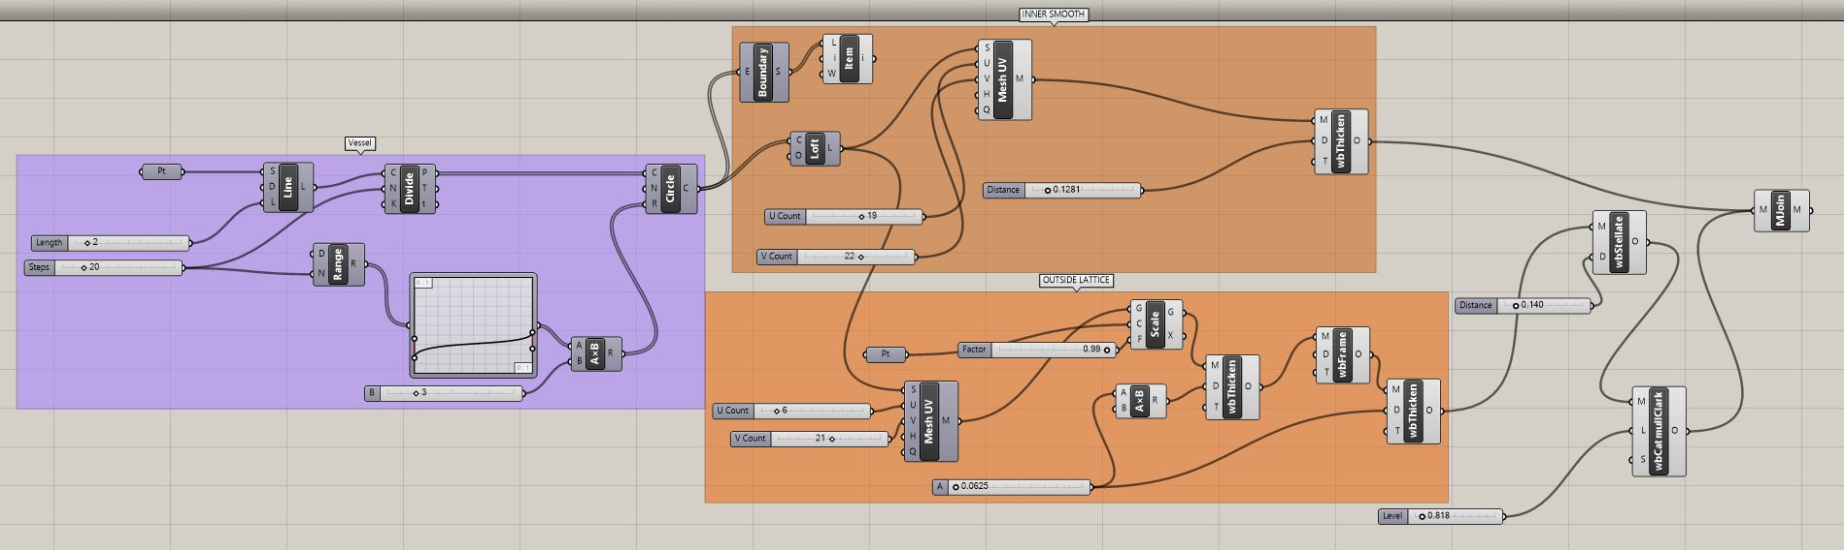
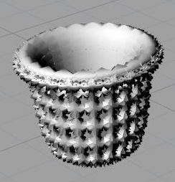
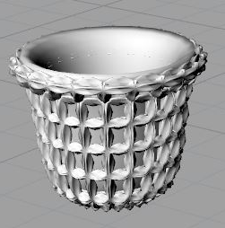
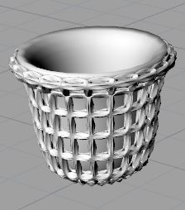
Employing the Stellate Mesh
Stellate 8.140
U = 4
V = 21
Dist =
5.140
Stellate 8.140
U = 4
V = 21
Dist =
4.125
Stellate 8.140
U = 4
V = 21
Dist =
3.680
Decreasing the depth of the Stellate Mesh

Slide 9
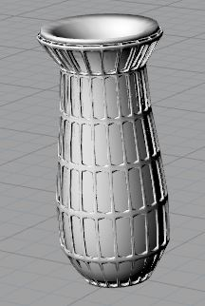
Tokkuri
Created by adjusting the Sliders and Bezier Curve controlling the concentric circles and form of the initial Vessel, respectively

Slide 10
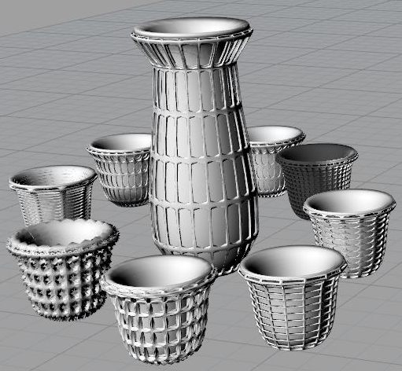
Final Collection

