Slide 1
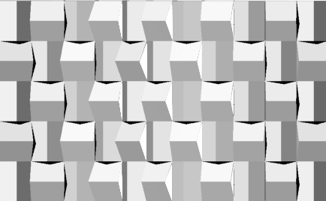
Privacy Screen For Kids
Elizabeth Gomez

Slide 2
DESIGN INTENT
“Kneel and Peek” is a privacy screen for kids that is intent is to create a playful environment. The child in once side of the screen could walk, kneel or lay down and peek to see what is at the other side of the screen. Creating a similar action like hide and seek. At the other side of the screen the joinery of the components create a grid. In this area kids can place their toys and used them for later. Creating this display the kids will know what toys they have or what could they play with while looking through the privacy screen.
The wall is created by two set of components. One component creating a fold in a horizontal way and the other component creating a fold in a vertical way. The variation consists on the extension of the components and the extension of the joint connector. The wall could also vary in the amount of components it has.

Slide 3
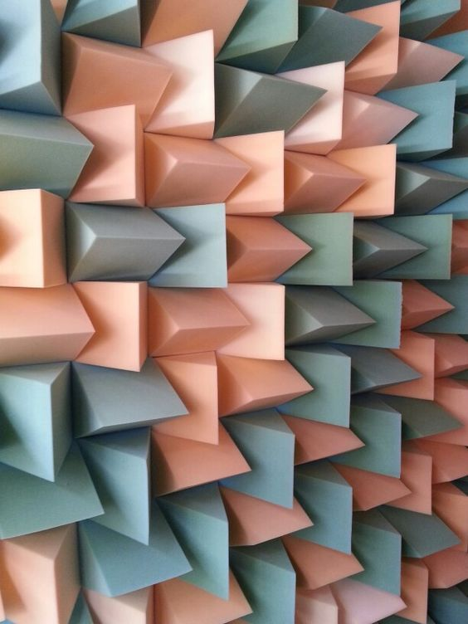
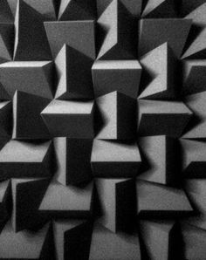
PRECEDENT

Slide 4
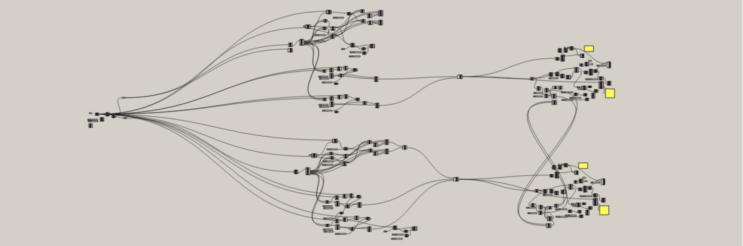
Grasshopper Definition

Slide 5
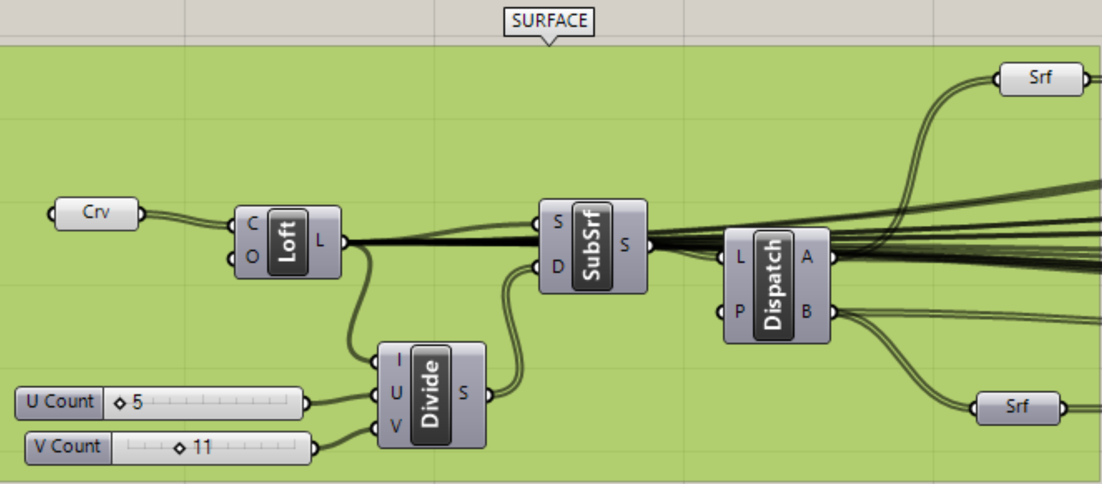
SURFACE

Slide 6
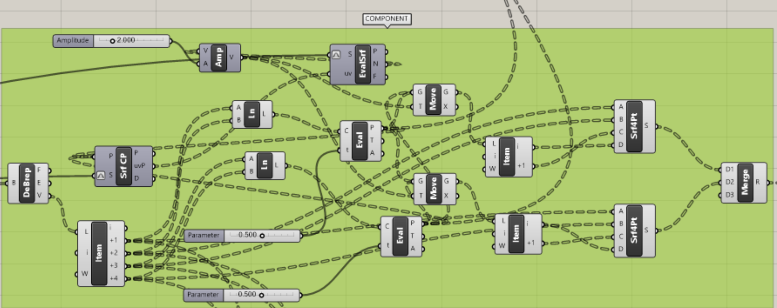
COMPONENTS

Slide 7
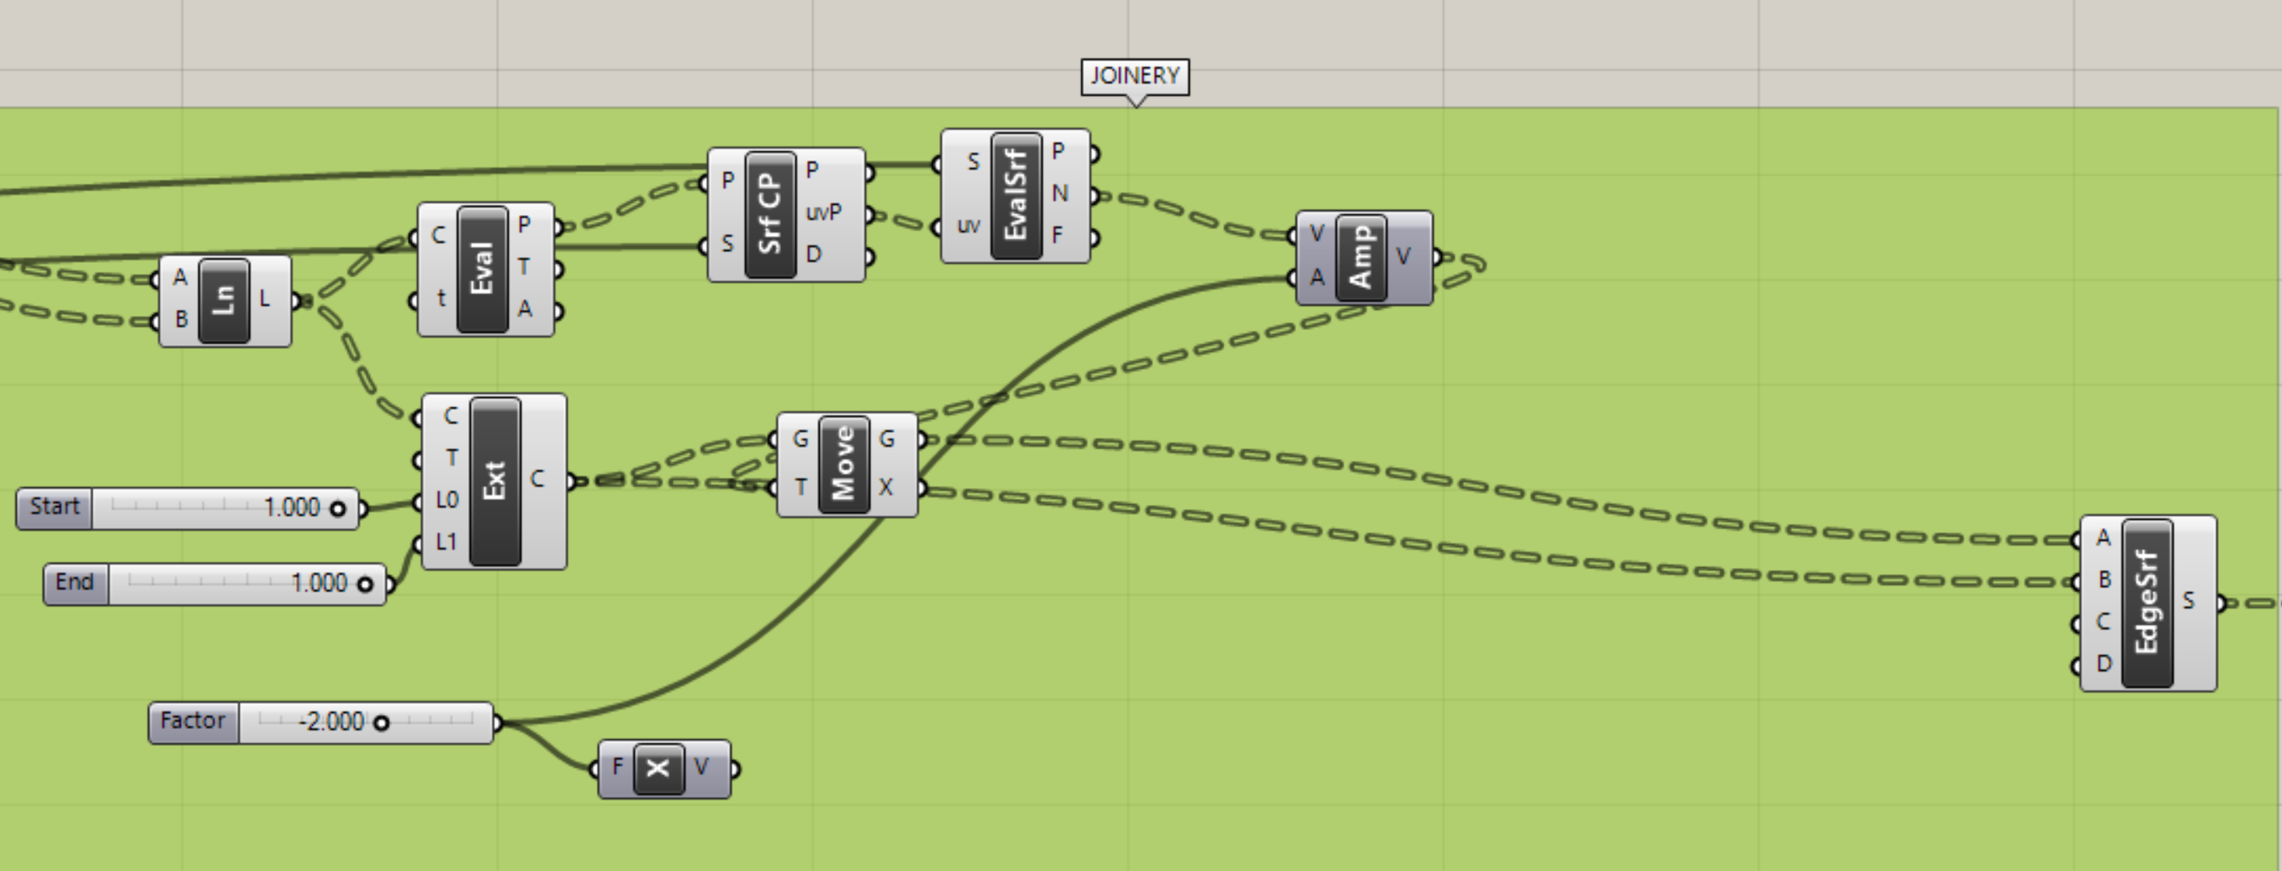
JOINERY

Slide 8
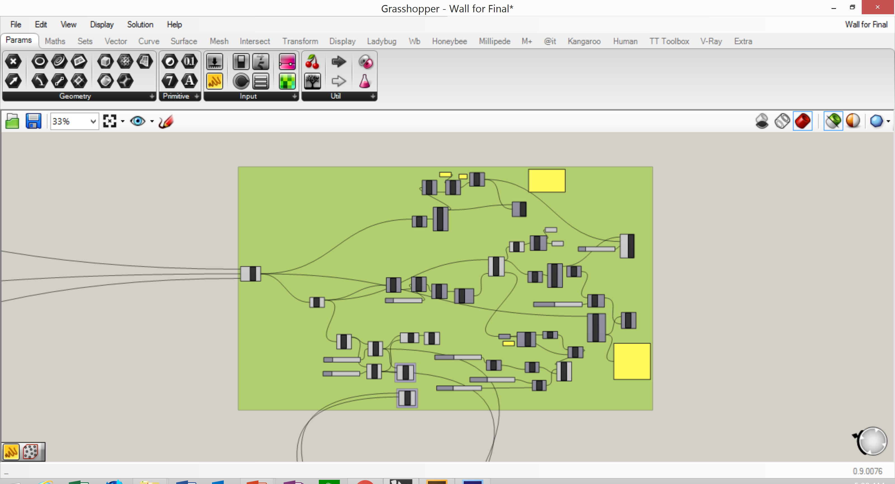
2D UNFOLD COMPONENTS

Slide 9
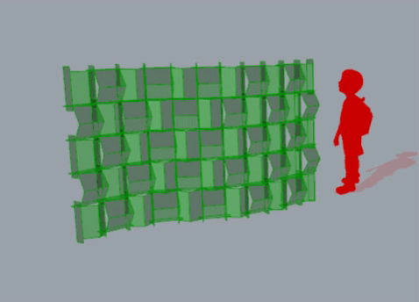
Component variable

Slide 10
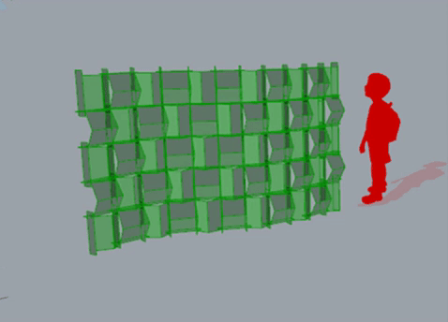
EXTENSION variable

Slide 11
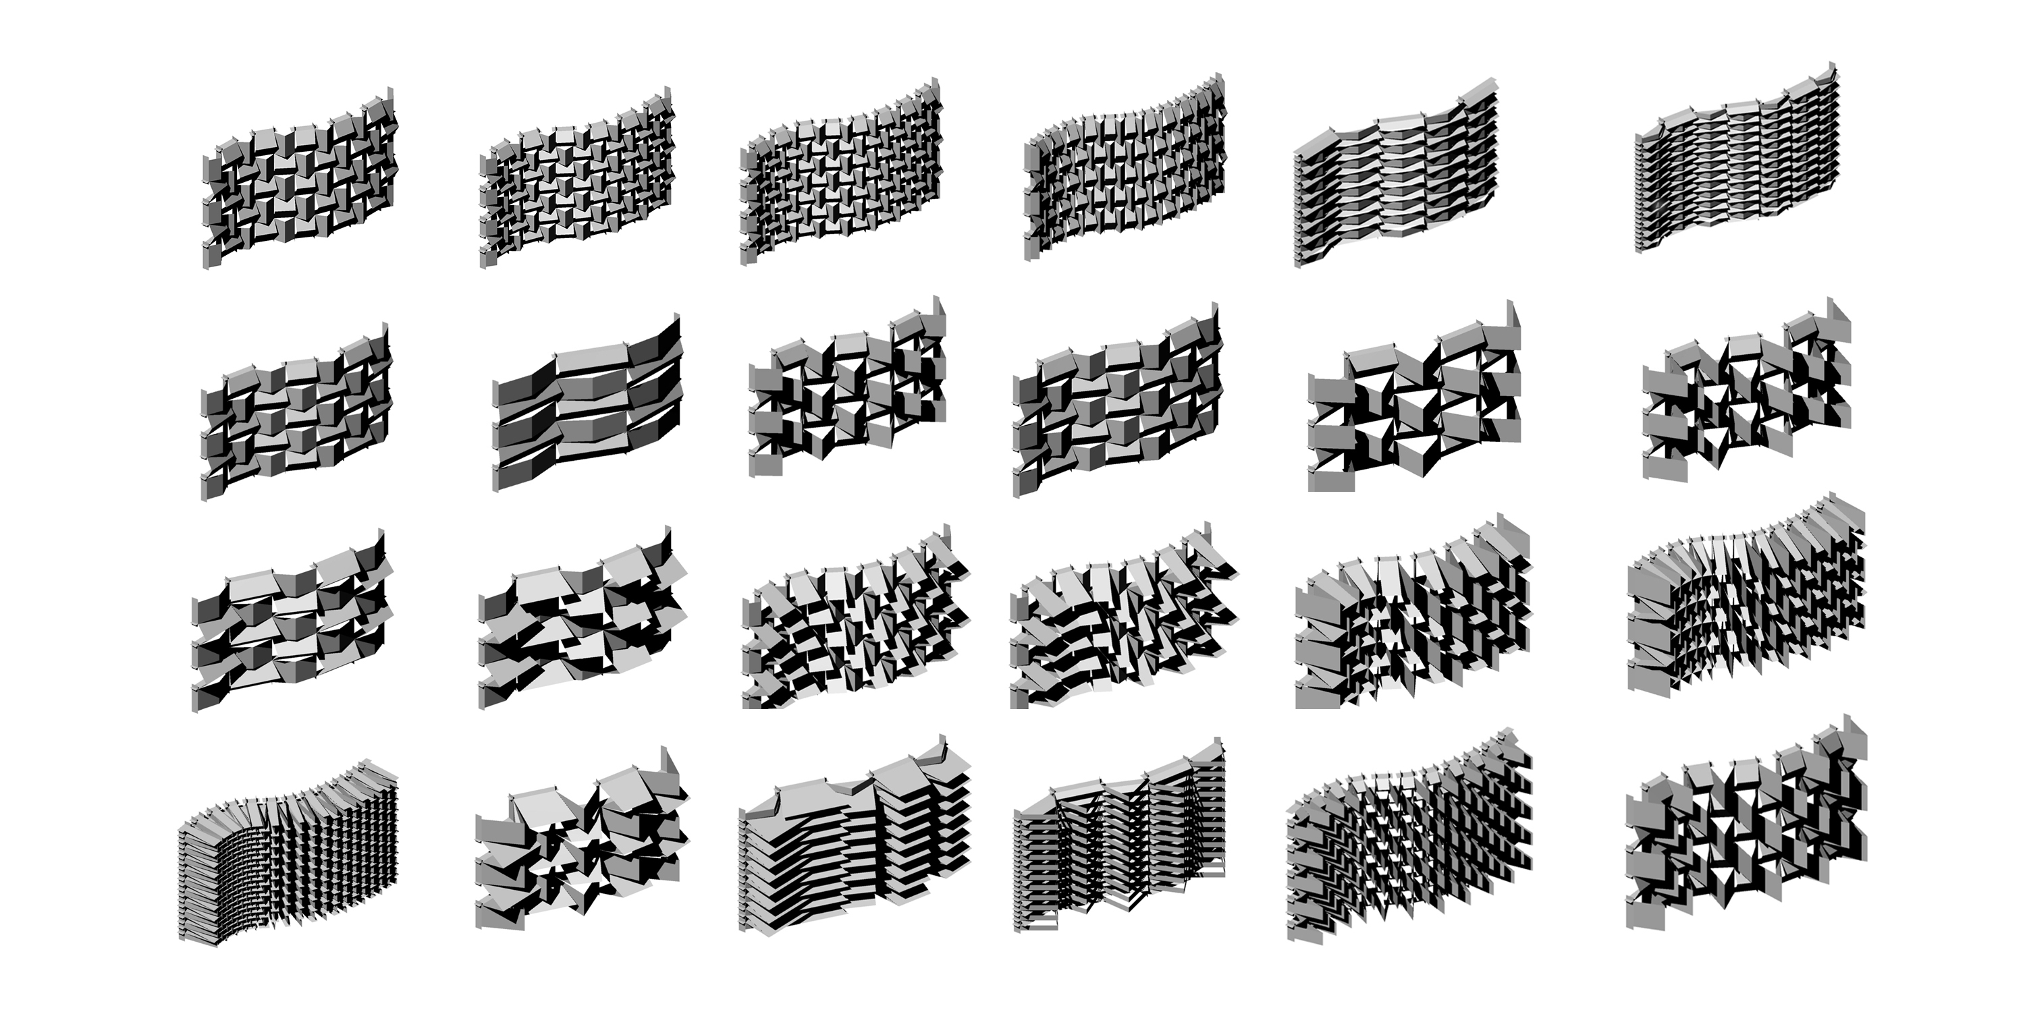
PRODUCT FAMILIES

Slide 12
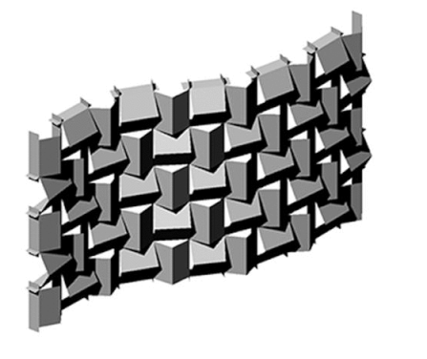
PRODUCT FAMILIES

