Slide 1
Project 1: Product Families
INT731 Parametrics
Professor Benjamin Howes
Qinghua Wang

Slide 2
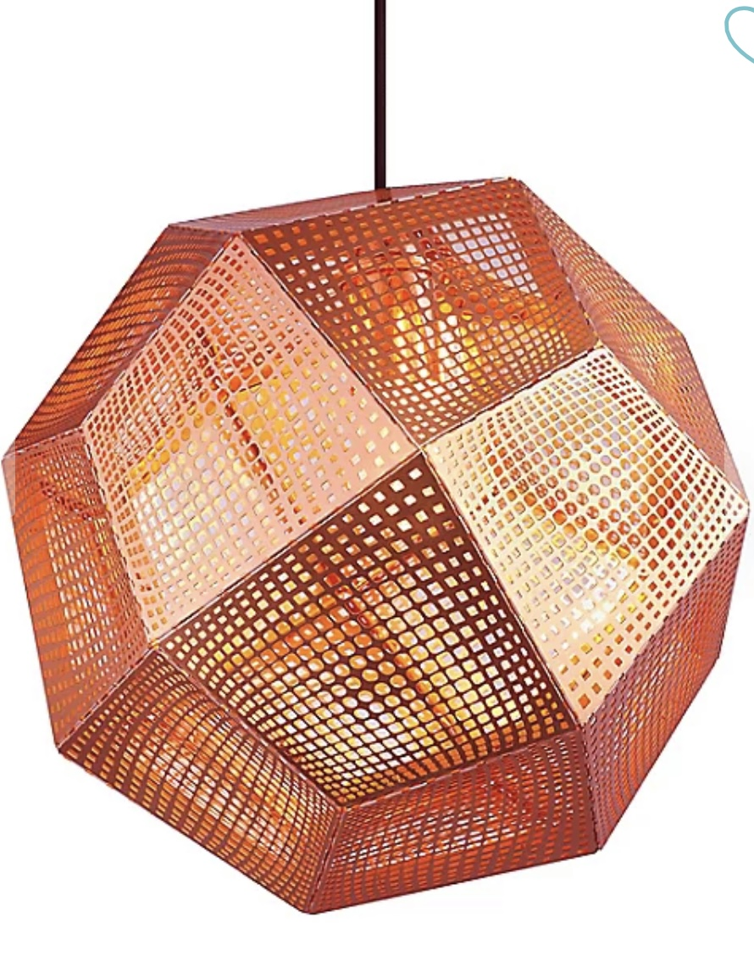
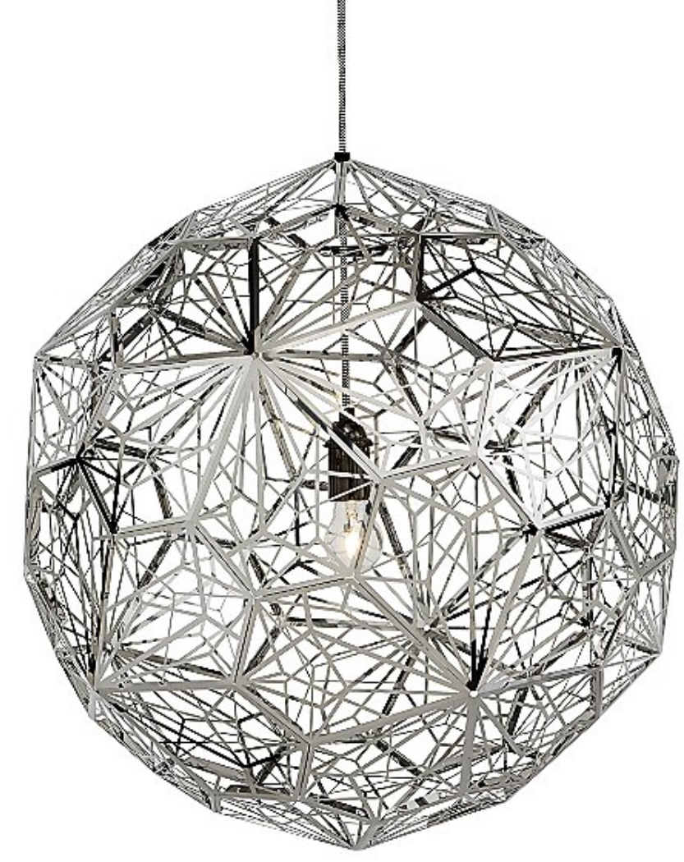
PRECEDENT

Slide 3


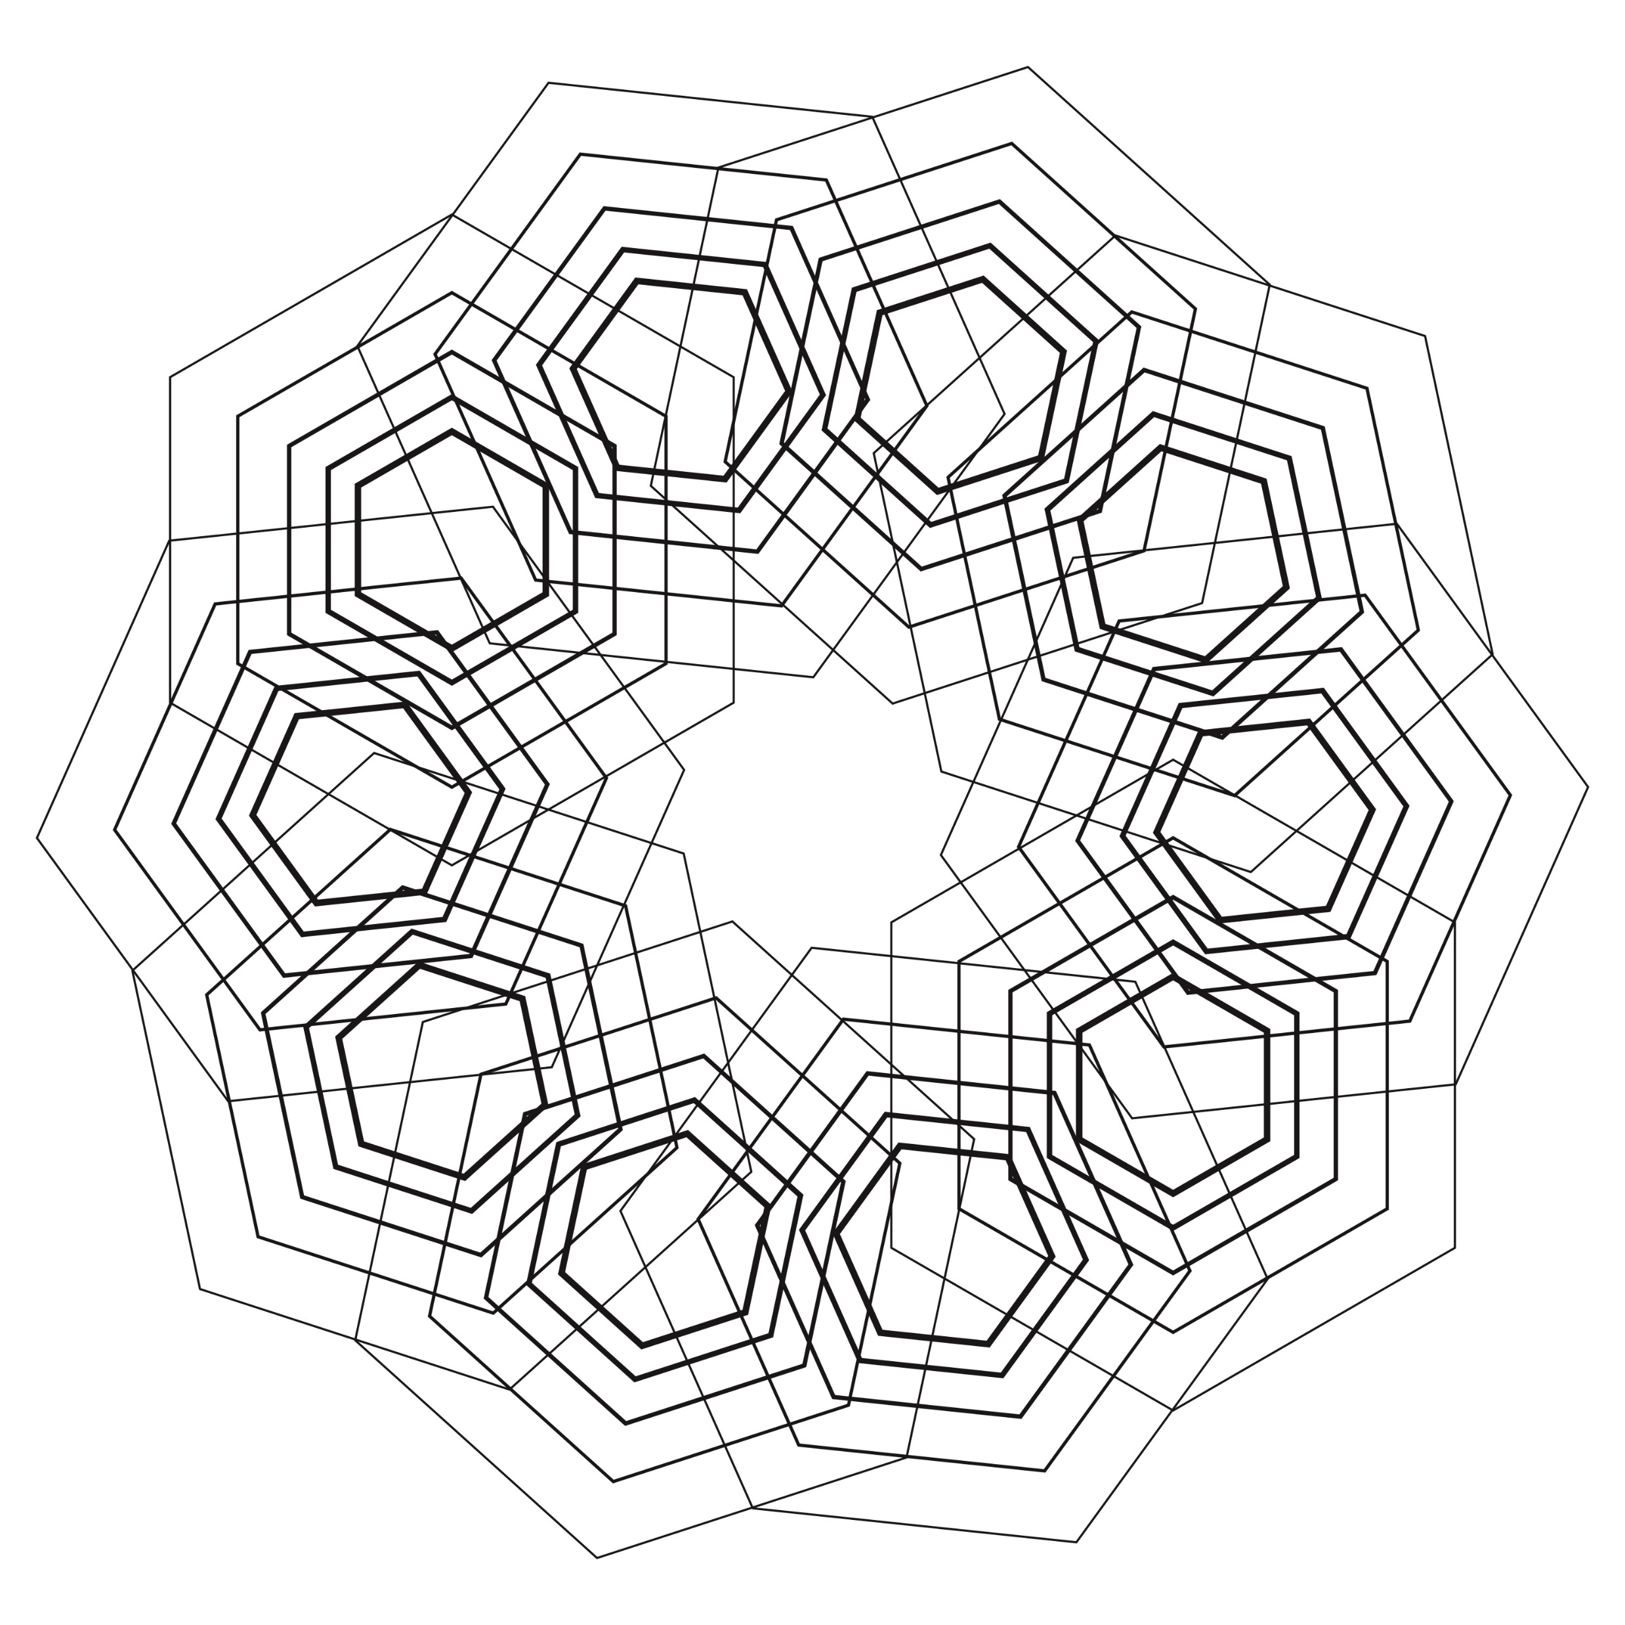
DIAGRAM

Slide 4
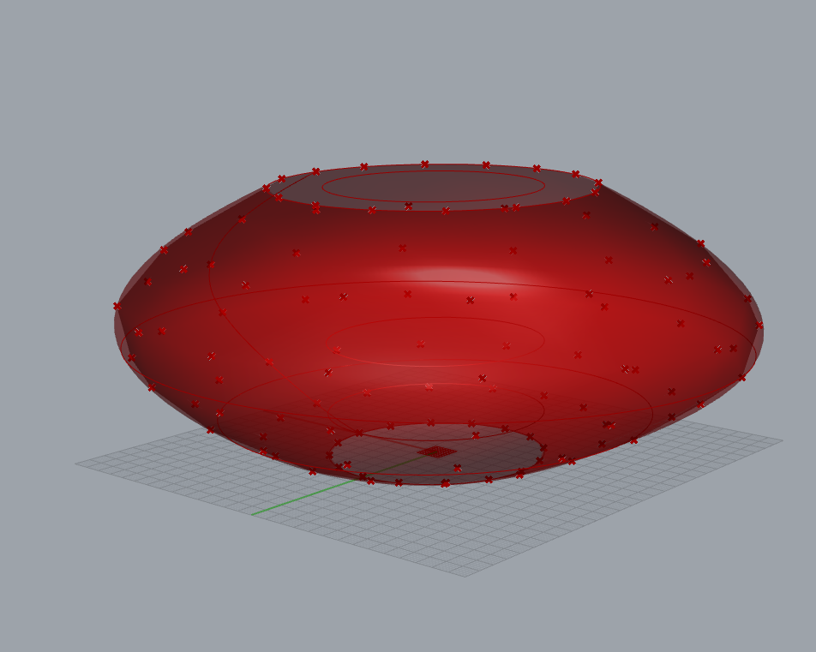
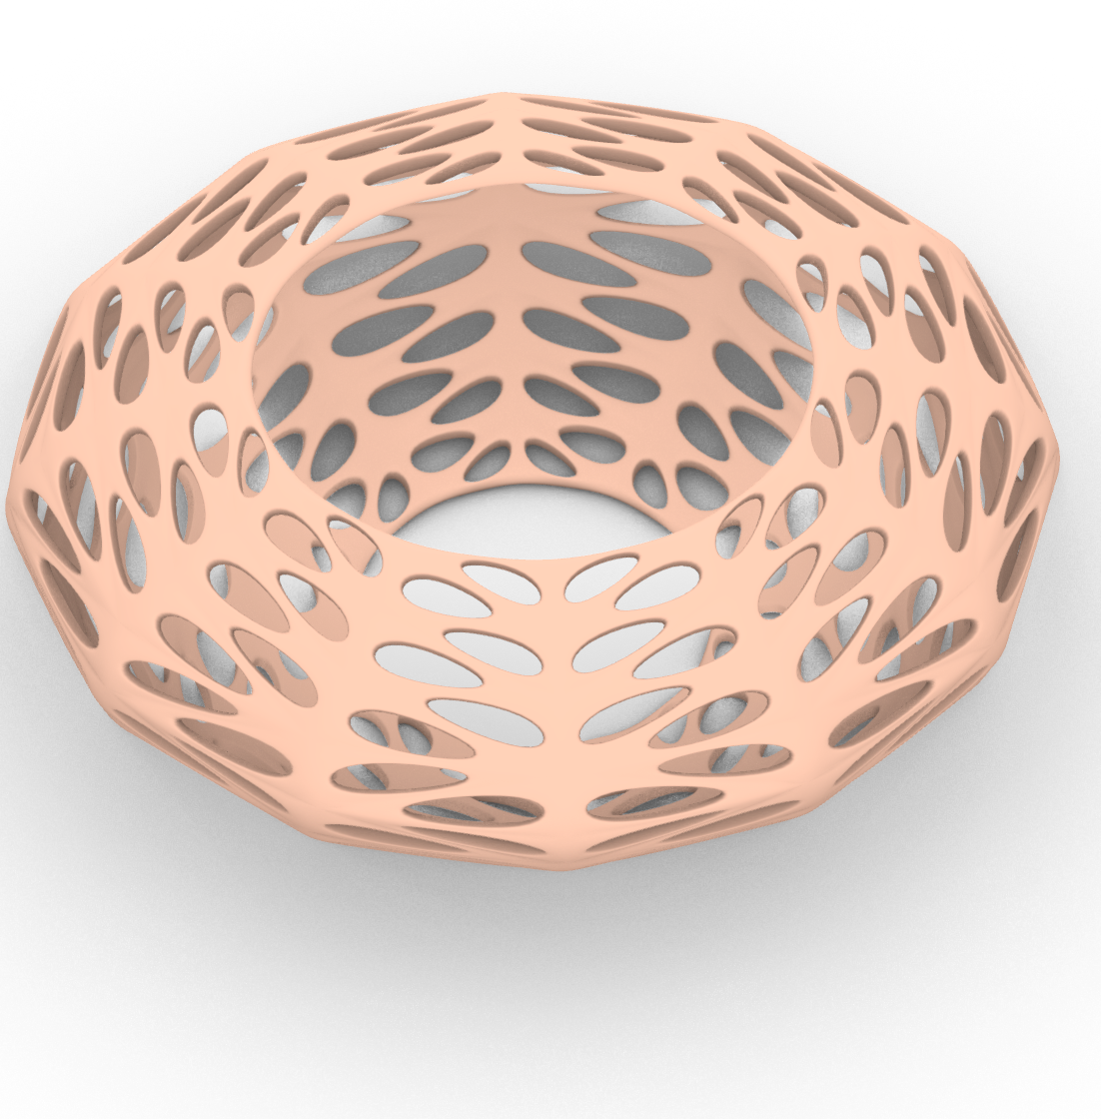
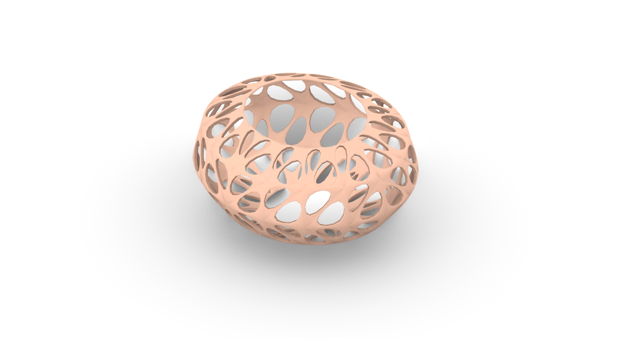
Process

Slide 5
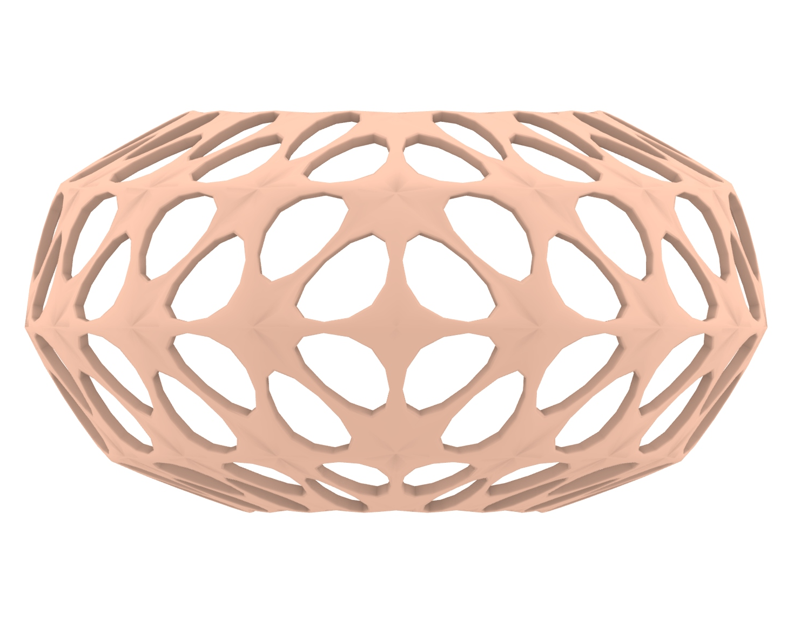
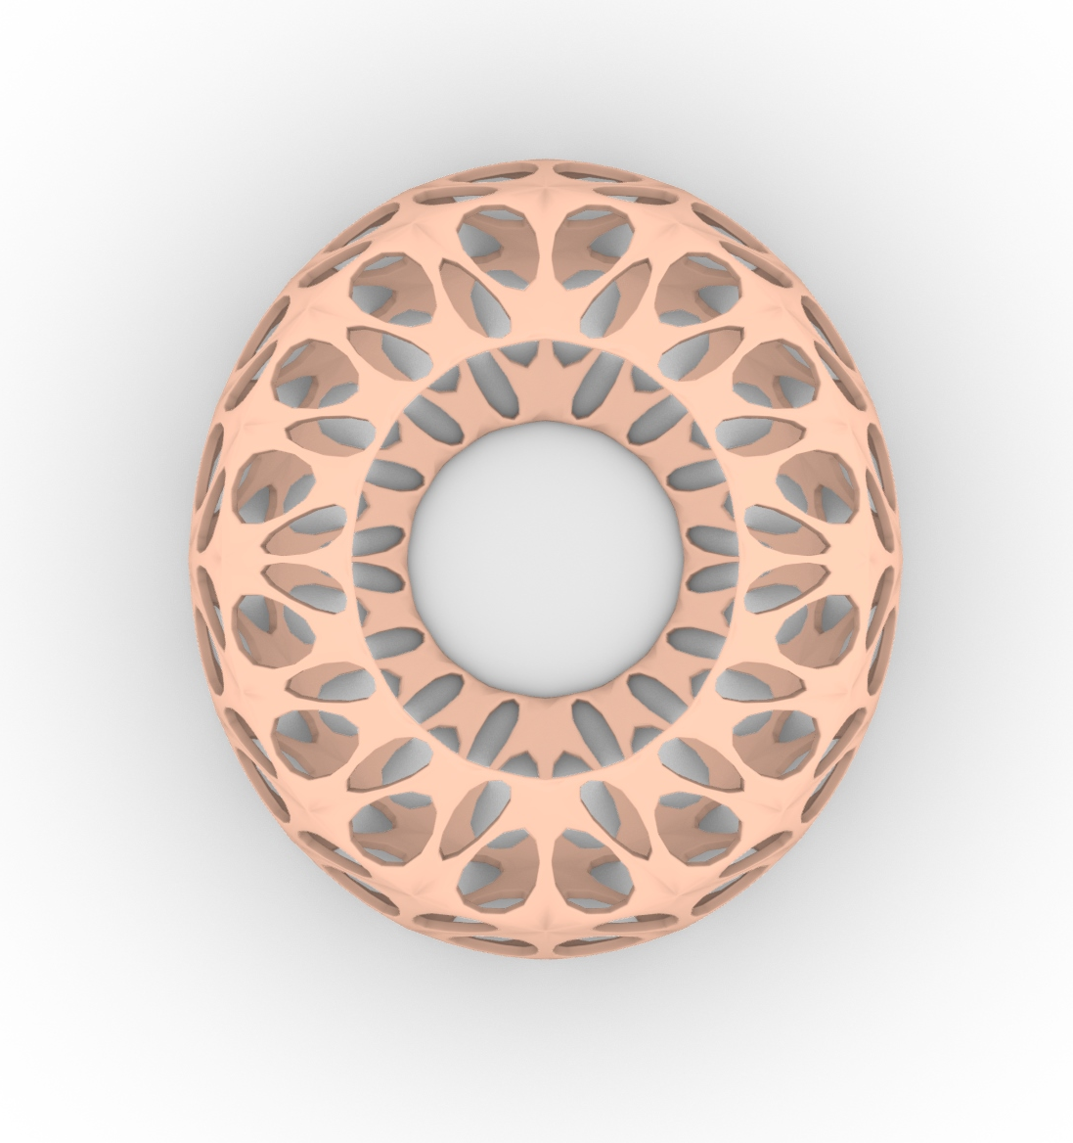
Light Diffuser for Tea Light

Slide 6
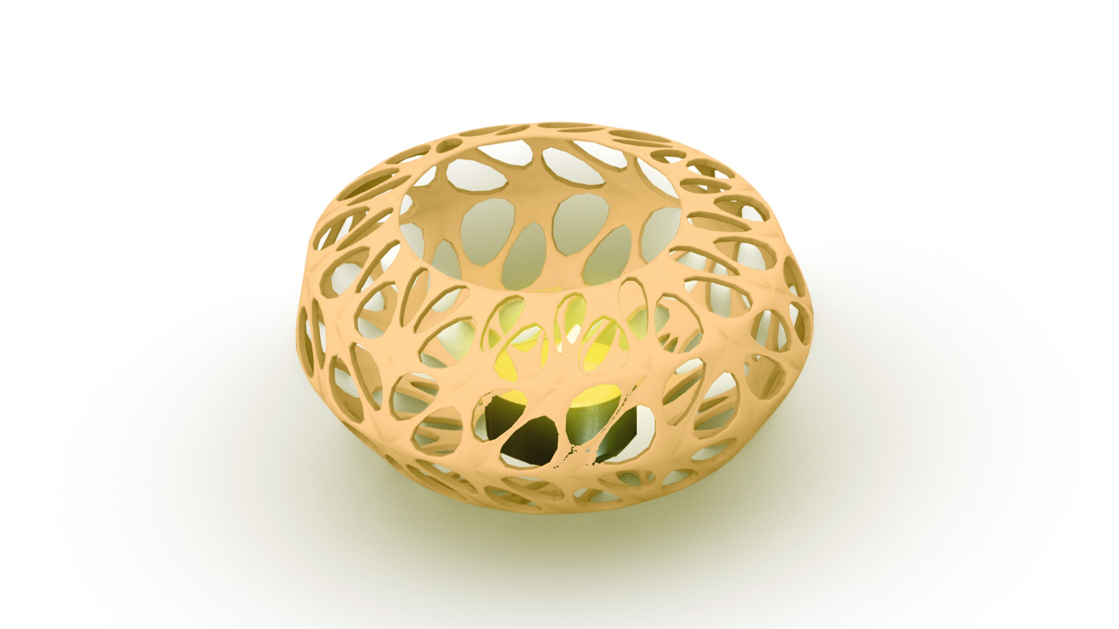

Slide 7
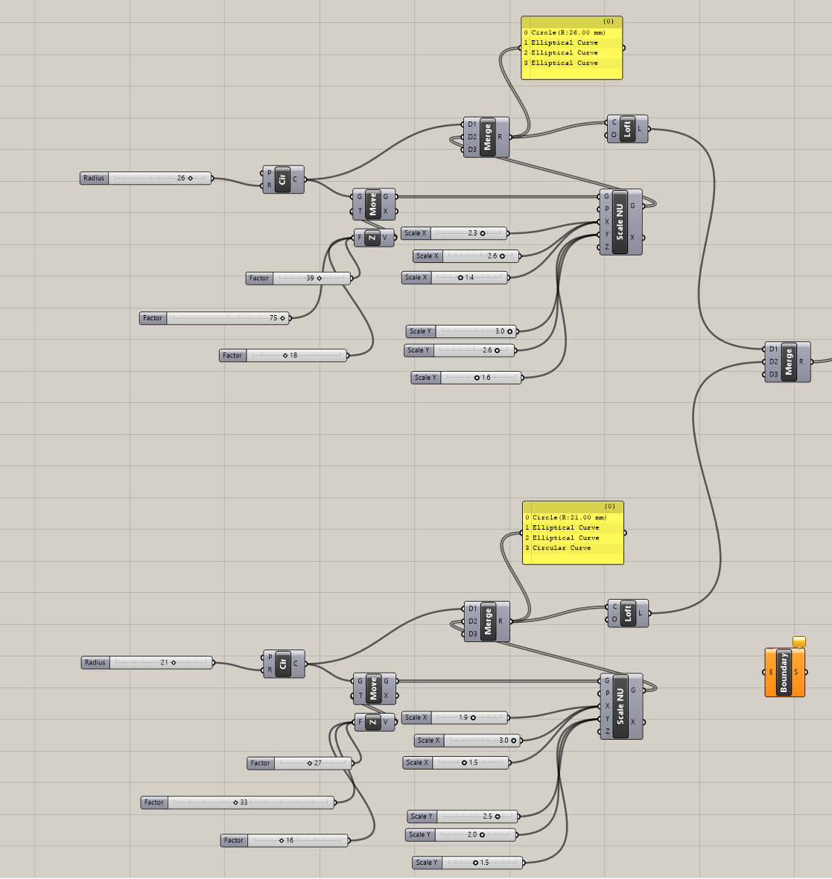
Grasshopper

Slide 8
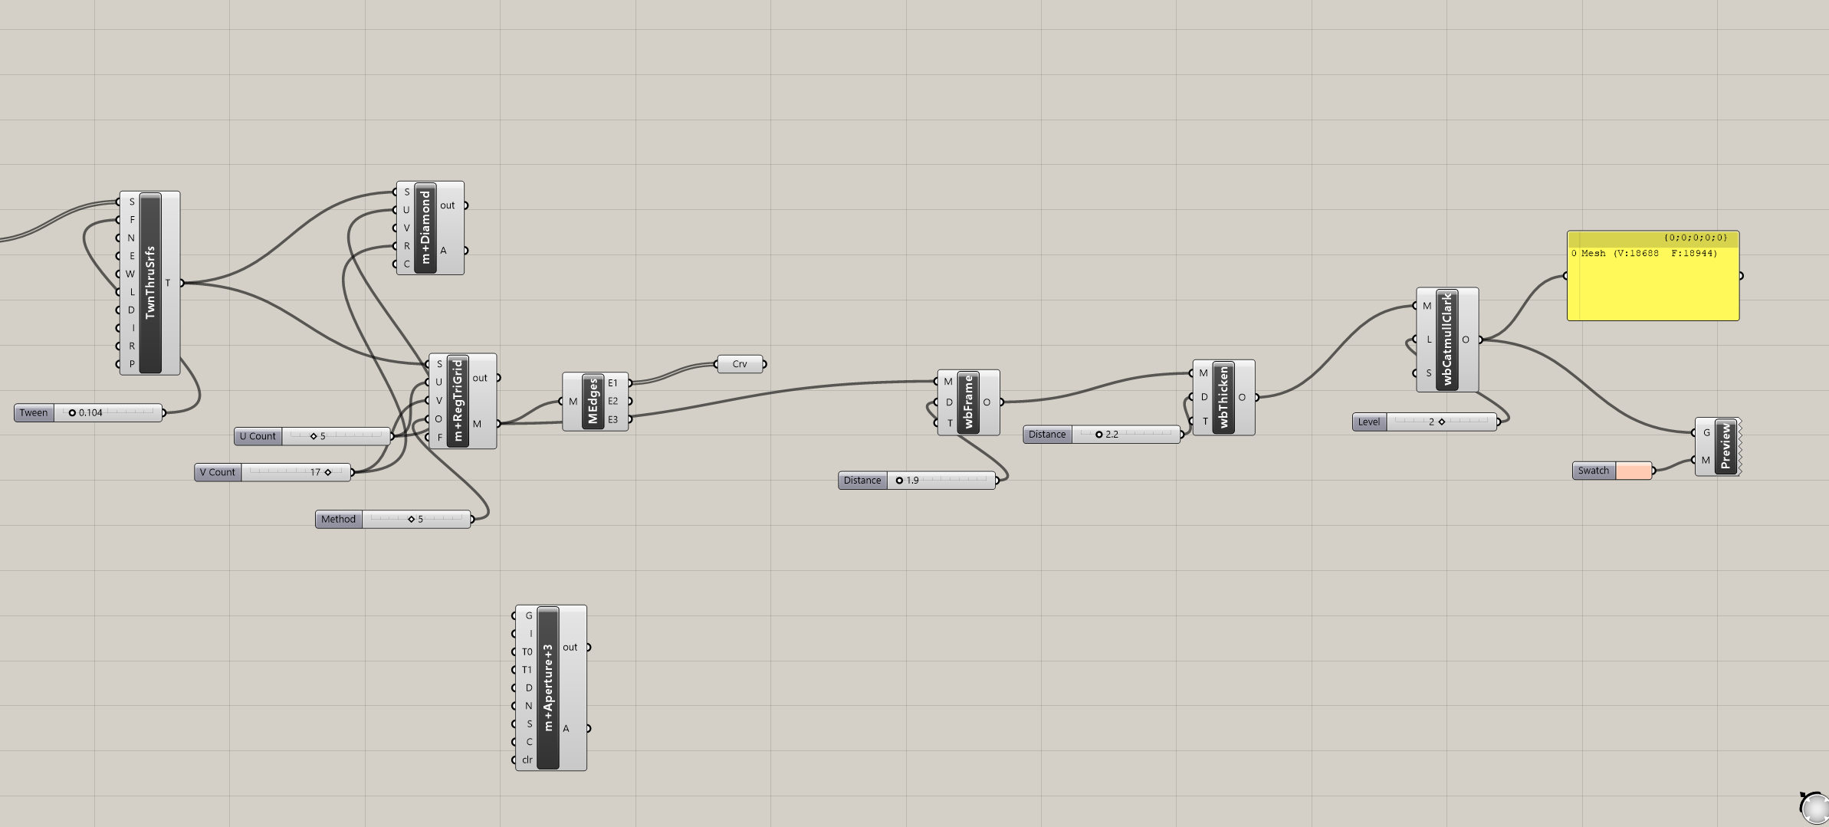

Slide 9
Next Step
Change the volume of the light diffuser
Change the shape of the void
Make size variation of the void

